Slide 1
Marketing mix modelling
Exhibition Insights & Analytics
Data Science & Insights Team

Slide 2
Opening scene: the agenda
Budget Planning
  Budget Scenarios by Attendance Estimates
  Budget Summary by Funnel
Channel Planning
  ROI Analysis by Channel
  Channel – Specific Performance Review
LOB Overview
  ROI Analysis by LOB
  Flighting and Insights
  LOB Budget Summary
  LOB – Specific Performance Review
This iteration of MMM accounts for data Q2 2023 to Q1 2025

Slide 3
Summary OF OUTPUTS

Slide 4
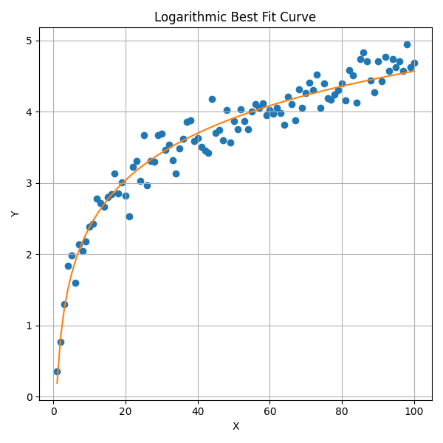
Scenario analysis methodology
Approach
The model analyzes campaign spend throughout 2024 and corresponding EXH attendance to simulate a budget curve. Each week’s spend is mapped to its contribution, with thousands of simulations generating a best-fit curve.
Methodology
Simulations assume a realistic spend ceiling based on domain knowledge to estimate where marginal returns begin to diminish significantly.
Output
The resulting budget curve illustrates expected returns at different spend levels, with Marginal ROI calculated as the slope at each point along the curve.
Variables
Weekly media spend is used as the predictor, and weekly campaign contributions to LBE transactions are the predicted variable
(Above is an example and does not represent actual data)

Slide 5
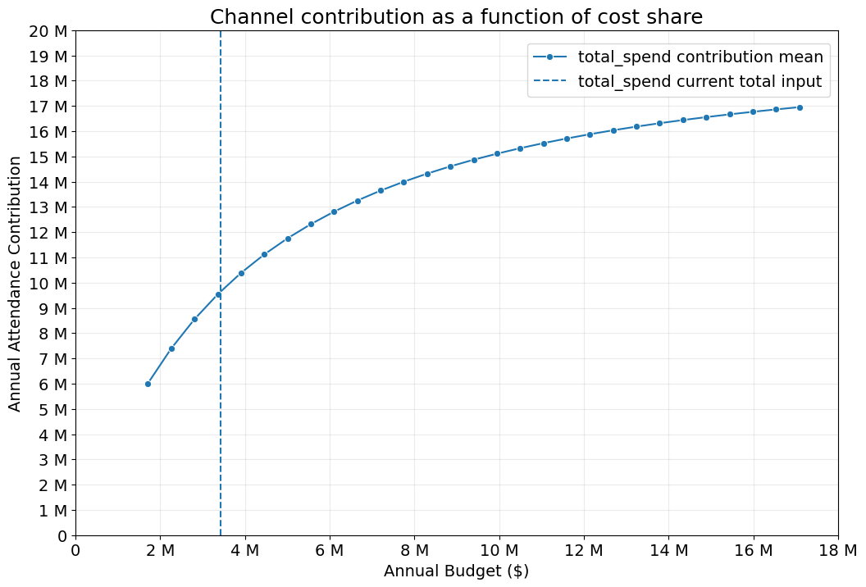
BUDGET SCENARIO analysis
Current Spend (~$3.1M) is in the Steep-Growth Zone. Implying solid returns on each additional dollar spent.
The curve continues to rise steadily beyond the current spend, indicating room for growth.
Increasing budget modestly (e.g. $1M-$2M more) would likely still generate strong incremental revenue.
Increasing the budget from around $4M to $5M would result in $4M additional revenue contribution.
Returns on additional spend diminish as the budget increases. At one point, the budget would have to increase by $4M to receive $1M in revenue contribution.
2024

Slide 6
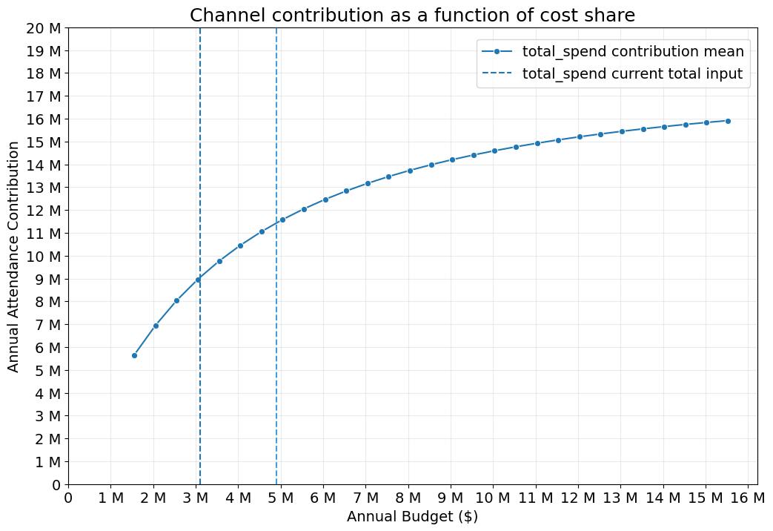
BUDGET SCENARIO analysis
2024
2025

Slide 7
BUDGET SCENARIO analysis
 | Business As Usual (2024) | Business As Usual (2025) | 44M Attendance (BAU) | 46M Attendance (5% higher) | 48M Attendance (10% higher)
Budget (ex-PR) | 3.4M | 4.9M | 4.9M | 7.2M | 13.6M
Budget | 3.6M | 5.0M | 5.0M | 7.5M | 14.0M
Media Attendance Contribution | 10.0M | 12.0M | 12.0M | 14.0M | 16.0M
Media Profit Contribution | 153.4M | 153.4M | 184.1M | 214.8M | 245.4M
Marginal Attendance ROI | 1.4 | 1.0 | 1.0 | 0.7 | 0.4
Marginal Revenue ROI | $33.0 | $23.6 | $23.6 | $16.5 | $9.4
Brand / Exhibition | $1.5M | $1.7M | $2.6M | $3.8M | $5.6M
Film | $0.9M | $0.7M | $1.0M | $1.5M | $2.2M
Performance | $0.4M | $1.4M | $0.6M | $0.9M | $1.3M
Cineclub | $0.2M | $0.4M | $0.2M | $0.3M | $0.4M
Prepaid | $0.1M | $0.2M | $0.1M | $0.2M | $0.2M
PR | $0.1M | $0.1M | $0.2M | $0.3M | $0.4M
Other (F&B, G&E) | $0.3M | $0.4M | $0.4M | $0.6M | $0.9M
Notes:
Media Profit Contribution assumes revenue of $23.6 per attendee with a 65% gross profit margin.
Marginal Revenue ROI assumes revenue of $23.6 per attendee
Link to worksheet

Slide 8
BUDGET SUMMARY FOR AWARENESS campaigns
2026 Awareness Budget Input |  | $750,000 |  |  | 2-Year Actual Past Budget |  | $1,507,726
 |  |  |  |  | Weeks |  | 52
Line of Business | Channel | Contribution to Attendance (all factors) | Contribution to Attendance (internal factors only) | Spend Proportion (trailing 2 years) | Actual Yearly Spend (trailing 2 years' avg) | Model-based 2026 Allocation | Model-based 2026 Allocation / week
PR | PR | 3.1% | 22.5% | 24.1% | $181,375 | $168,478 | $3,240
Brand | Programmatic | 3.3% | 23.9% | 51.2% | $385,602 | $179,348 | $3,449
Brand | Meta | 3.0% | 21.7% | 12.9% | $97,483 | $163,043 | $3,135
Cineclub | Programmatic | 2.9% | 21.0% | 1.8% | $13,436 | $157,609 | $3,031
F&B | Meta | 1.5% | 10.9% | 10.1% | $75,967 | $81,522 | $1,568
Total |  | 13.8% | 100.0% | 100.0% | $753,863 | $750,000 | $14,423
Awareness campaigns account for ~14% of all attendance when factoring in weather, baseline attendance, and other external factors.
Programmatic Brand
Highest spend
Highest attendance contribution
Appropriate budget allocation.
Programmatic Cineclub
Lowest spend
Average contribution to attendance
Less-than-ideal allocation
Link to worksheet

Slide 9
BUDGET SUMMARY FOR consideration campaigns
2026 Consideration Budget Input |  | $750,000 |  |  | 2-Year Actual Past Budget |  | $1,489,114
 |  |  |  |  | Weeks |  | 52
Line of Business | Channel | Contribution to Attendance (all factors) | Contribution to Attendance (internal factors only) | Spend Proportion (trailing 2 years) | Actual Yearly Spend (trailing 2 years' avg) | Model-based 2026 Allocation | Model-based 2026 Allocation / week
Brand | Programmatic | 9.3% | 33.9% | 7.9% | $58,810 | $254,562 | $4,895
Brand | Meta | 1.6% | 5.8% | 28.7% | $213,613 | $43,796 | $842
Enhanced | Programmatic | 0.6% | 2.2% | 1.9% | $14,155 | $16,423 | $316
Exhibition | SEM | 0.9% | 3.3% | 7.3% | $54,713 | $24,635 | $474
Film | Programmatic | 1.6% | 5.8% | 5.7% | $42,297 | $43,796 | $842
G&E | Social | 1.9% | 6.9% | 10.0% | $74,745 | $52,007 | $1,000
G&E | SEM | 1.8% | 6.6% | 0.4% | $2,986 | $49,270 | $948
G&E | Meta | 1.2% | 4.4% | 10.5% | $78,382 | $32,847 | $632
PR | PR | 6.0% | 21.9% | 24.4% | $181,375 | $164,234 | $3,158
Prepaid | Programmatic | 2.5% | 9.1% | 3.2% | $23,484 | $68,431 | $1,316
Total |  | 27.4% | 100.0% | 100.0% | $744,558 | $750,000 | $14,423
Consideration campaigns account for ~27% of all attendance when factoring in weather, baseline sales, and other external factors.
Programmatic Brand
Relatively low spend
Highest contribution to attendance
Under-allocation
Meta Brand
Highest spend
Contributed to around 6% of attendance
Overspend in channel
Link to worksheet

Slide 10
BUDGET SUMMARY FOR conversion campaigns
2026 Conversion Budget Input |  | $1,800,000 |  |  | 2-Year Actual Past Budget |  | $3,664,365
 |  |  |  |  | Weeks |  | 52
Line of Business | Channel | Contribution to Attendance (all factors) | Contribution to Attendance (internal factors only) | Spend Proportion (trailing 2 years) | Actual Yearly Spend (trailing 2 years' avg) | Model-based 2026 Allocation | Model-based 2026 Allocation / week
Brand | Programmatic | 2.6% | 4.8% | 1.9% | $34,326 | $86,347 | $1,661
Brand | Meta | 1.2% | 2.2% | 23.6% | $431,650 | $39,852 | $766
Cineclub | SEM | 4.2% | 7.7% | 1.9% | $34,249 | $139,483 | $2,682
Enhanced | Programmatic | 2.3% | 4.2% | 2.4% | $43,081 | $76,384 | $1,469
Enhanced | SEM | 2.3% | 4.2% | 4.1% | $74,220 | $76,384 | $1,469
Event | Meta | 2.2% | 4.1% | 1.8% | $32,321 | $73,063 | $1,405
Exhibition | SEM | 26.1% | 48.2% | 11.4% | $208,862 | $866,790 | $16,669
Film | Meta | 3.2% | 5.9% | 22.3% | $408,012 | $106,273 | $2,044
Film | Social | 1.0% | 1.8% | 7.6% | $138,777 | $33,210 | $639
Performance | Programmatic | 3.9% | 7.2% | 7.9% | $144,445 | $129,520 | $2,491
Performance | Social | 3.0% | 5.5% | 5.5% | $100,867 | $99,631 | $1,916
PR | PR | 2.2% | 4.1% | 9.9% | $181,375 | $73,063 | $1,405
Total |  | 54.2% | 100.0% | 100.0% | $1,832,183 | $1,800,000 | $34,615
Conversion campaigns account for ~54% of all attendance when factoring in weather, baseline sales, and other external factors.
SEM Exhibition
Highest contribution to attendance
Around 11% of spend allocated
High efficiency
Recommended higher spend
Meta Film and Meta Brand
Two highest spends
Low contribution to attendance
Overspend in channels
Supports the shift to Convert & Upgrade
Link to worksheet

Slide 11
Strategies that stole Budget spotlight
Key Takeaways:
Performance-focused campaigns (Convert & Upgrade) outperform Brand and Film’s previous-year strategy for driving lower-funnel conversions.
EXH SEM is the strongest conversion driver. Opportunity to scale spend and maximize attendance.
Upper-to-mid funnel Brand investment remains important — Programmatic and Video tactics are delivering strong impact and should continue to anchor awareness and consideration efforts.

Slide 12
Channels
Notes:
4:00

Slide 13
Channels summary

Slide 14
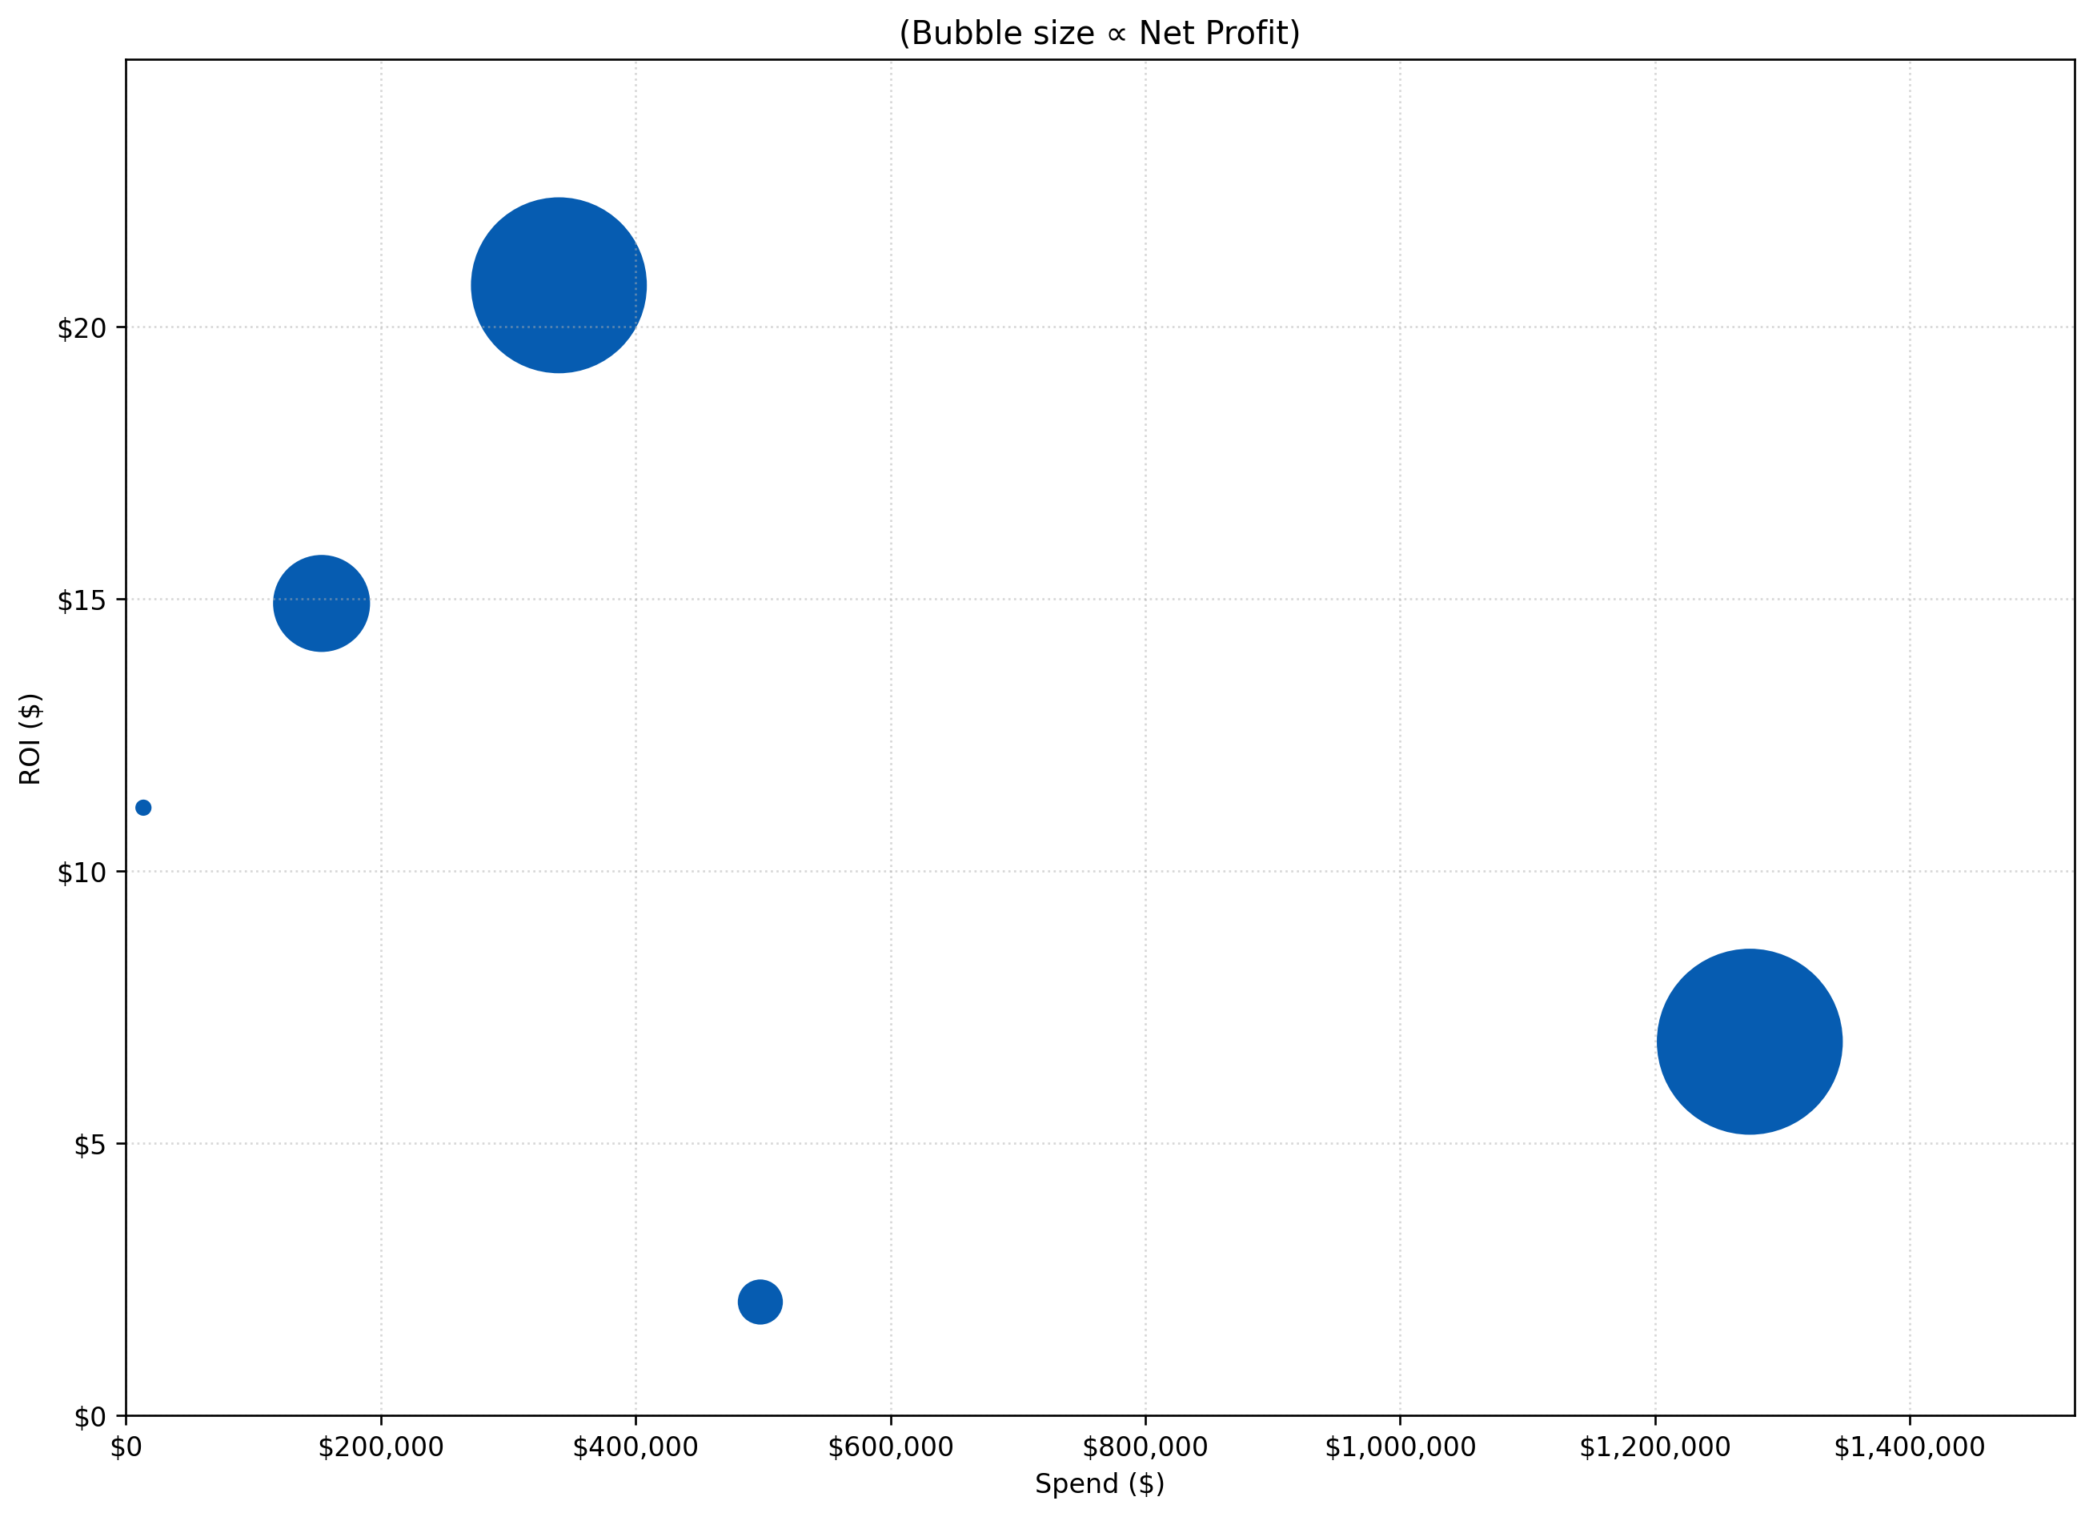
upper-funnel SPEND, net profit & ROI BY channel
Summary of spend and ROI by channel in upper-funnel campaigns
Bubble size indicates relative net profit
Notes:
Programmatic display shows positive performance with relatively low spend and highest ROI, also with high net profit
SEM is also observed to be efficient given the ROI and net profit relative to the small spend
Meta is less efficient with greatest spend allocation and second last ROI
Programmatic Display ($7M)
SEM ($2M)
Snapchat ($0.1M)
Meta ($7M)
Programmatic Video ($0.5M)
*Data covers Q2 2023 to Q1 2025
*Data does not consider external factors such as weather, holidays

Slide 15
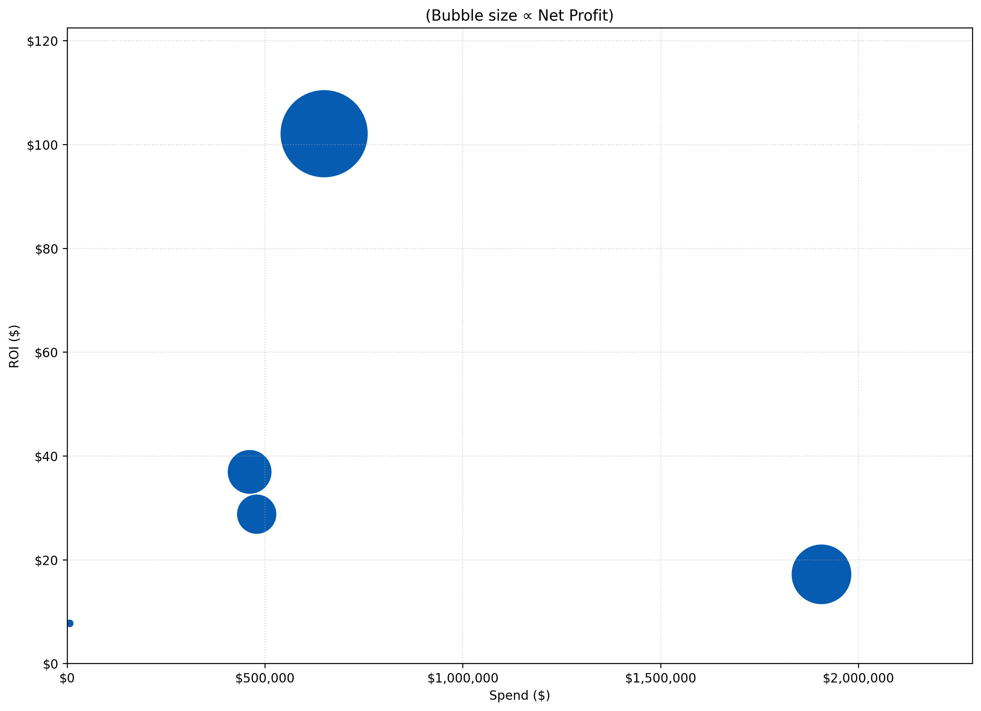
Lower-funnel SPEND, net profit & ROI BY channel
Summary of spend and ROI by channel in conversion campaigns.
Bubble size indicates relative net profit
Notes:
SEM shows very positive performance with relatively lower spend and highest ROI, also with highest net profit
Meta rather shows lower performance, with highest spend and second lowers ROI
SEM ($66M)
Programmatic Display ($17M)
Snapchat ($13M)
Meta ($31M)
Programmatic Video ($0.05M)
*Data covers Q2 2023 to Q1 2025
*Data does not consider external factors such as weather, holidays

Slide 16
sem
Notes:
6:00

Slide 17
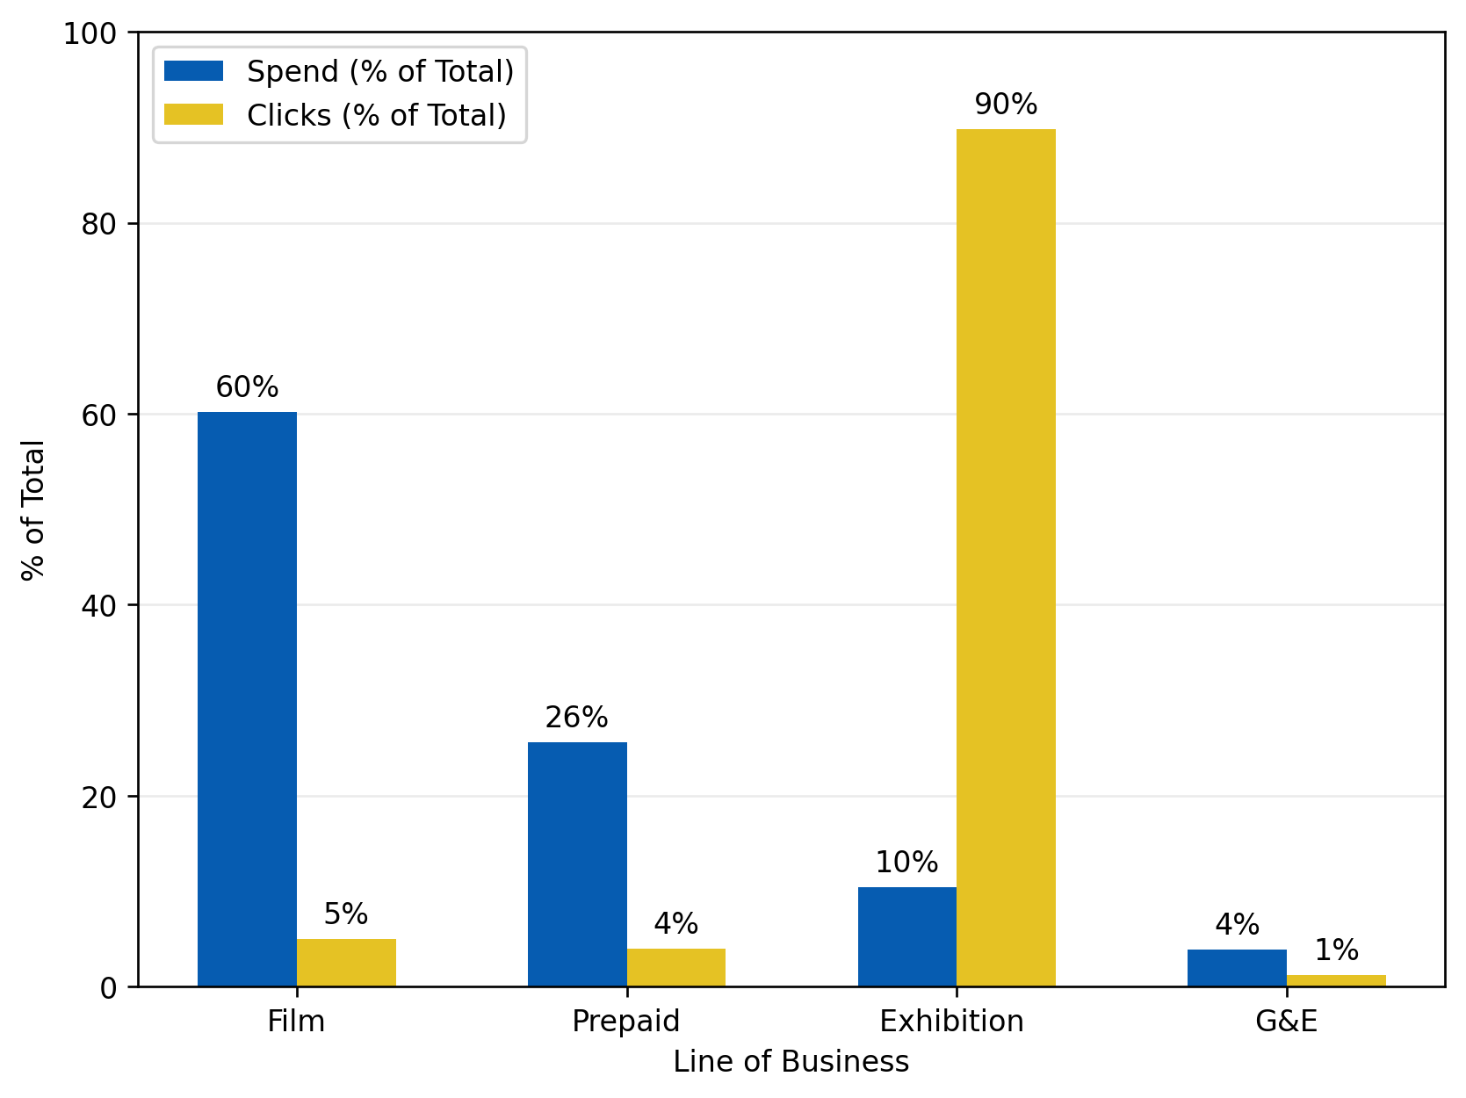
SEM Spend by lob vs clicks
Comparison of where budget is allocated vs where actual clicks are generated across the lines of businesses in the SEM channel with the purpose of customer consideration increase.
Notes:
High efficiency in Exhibition campaigns
Exhibition includes only one campaign (001_CP2K790)
Overspend in Film & Prepaid relative to engagement
Minimal impact from G&E
*Data covers Q2 2023 to Q1 2025
*Data does not consider external factors such as weather, holidays
Consideration Campaigns
Notes:
Exhibition only has one campaign: “EXH_B2C_G&E_National_CA_CONS_NON_EN_S CEA EXH 001_CP2K790 "

Slide 18
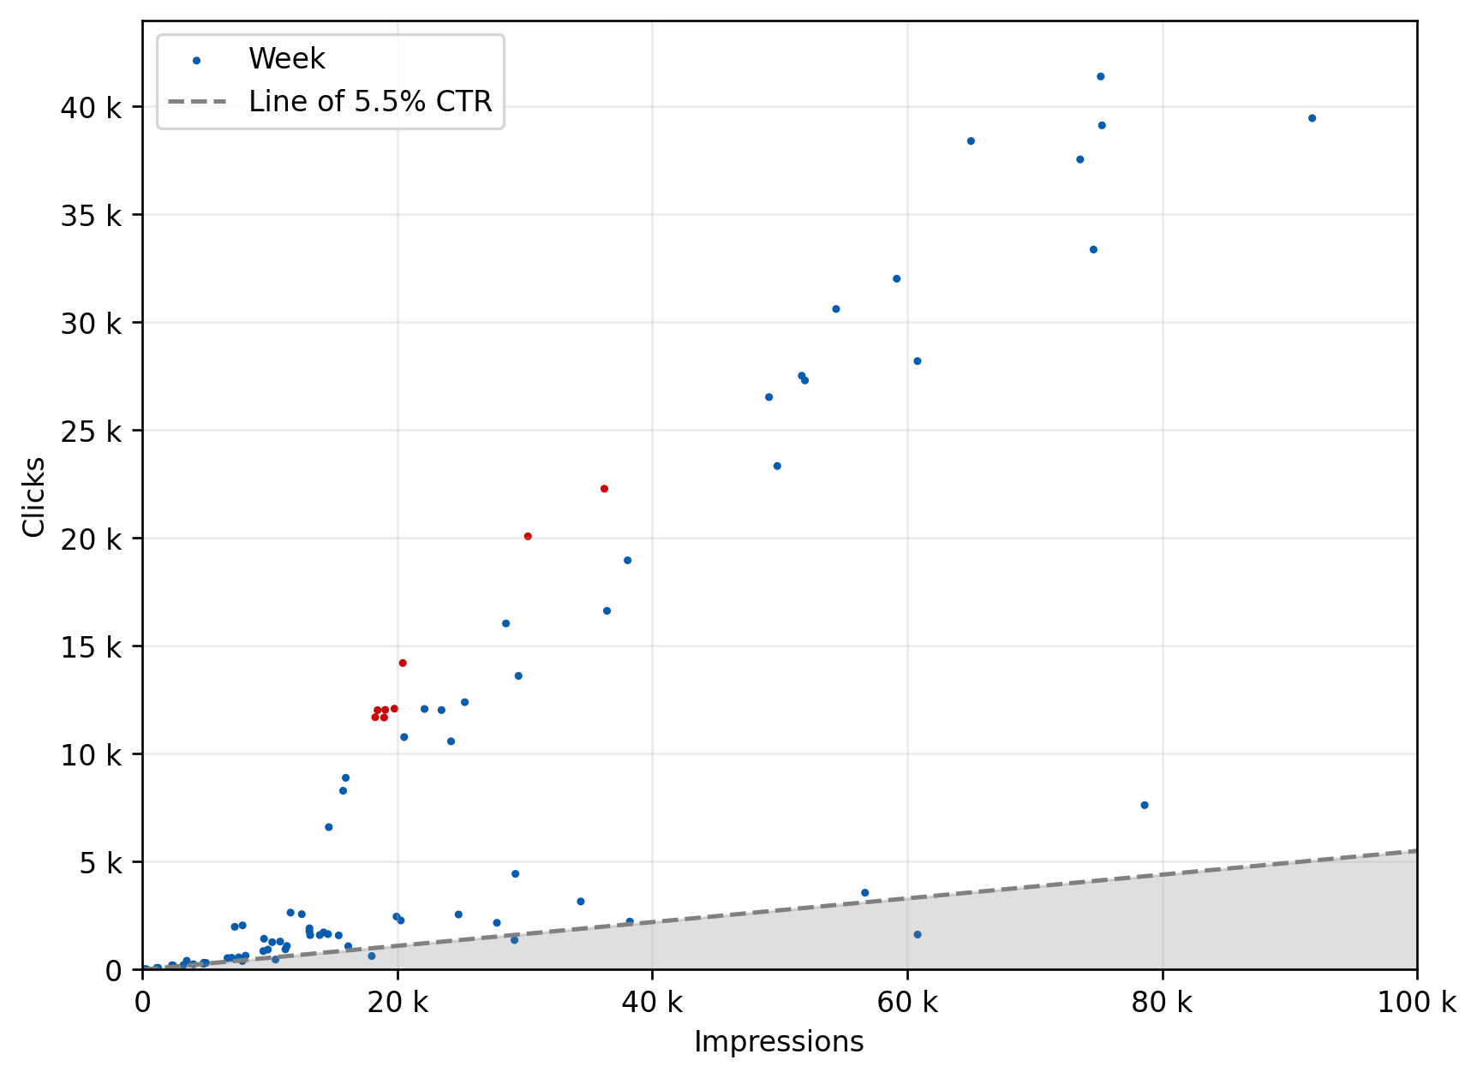
SEM Clicks by number of impressions
Relationship between the impressions & the number of clicks acquired for each week.
Notes:
Shaded area is where CTR < 25%
  Average CTR = 29%
  Midpoint CTR = 18%
Campaigns of less efficiency:
  Exp4ndables
  B2B Holiday
  B2C Holiday
Weeks highlighted in red had the highest click-through rate
Highlighted weeks include Inside Out 2 and Deadpool & Wolverine
2024-08-02
2024-06-28
Area of Inefficiency
*Data covers Q2 2023 to Q1 2025
*Data does not consider external factors such as weather, holidays
Consideration Campaigns

Slide 19
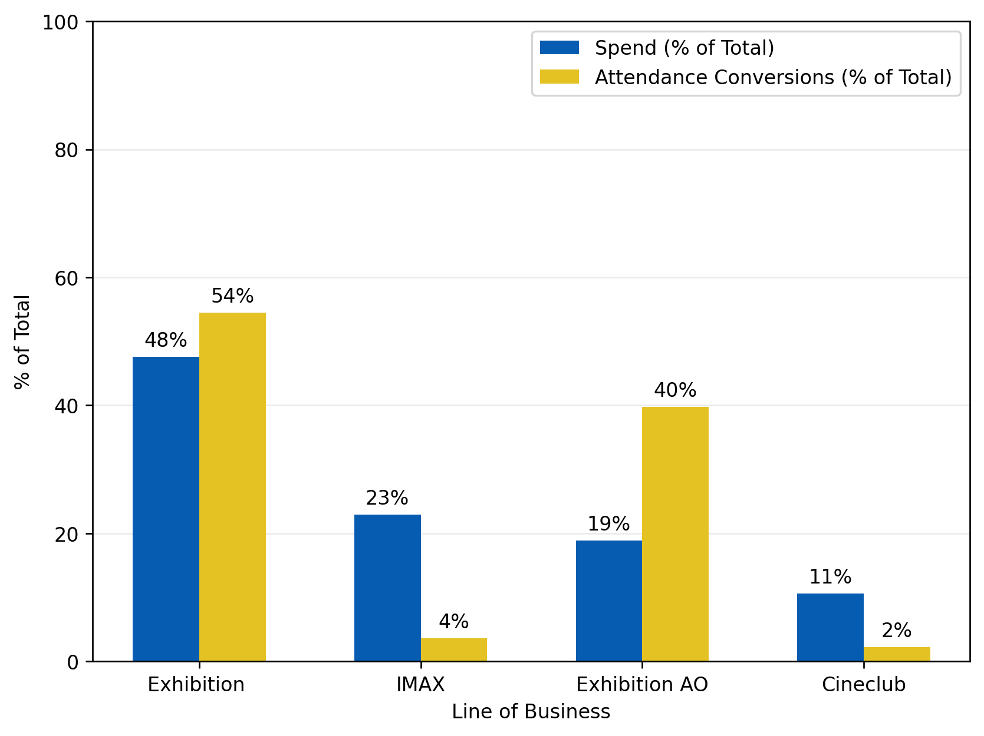
SEM Spend by lob vs Attendance conversions
Comparison of where budget is allocated vs where actual conversions are generated across the lines of businesses in the SEM channel with the purpose of attendance conversion increase.
Notes:
High efficiency in Exhibition campaigns
Overspend in IMAX & Cineclub relative to engagement
Campaign examples in Exhibition:
  21_CIN
  The Hunger Games: The Ballad of Songbirds & Snakes
  Barbie
*Data covers Q2 2023 to Q1 2025
*Data does not consider external factors such as weather, holidays
Conversion Campaigns

Slide 20
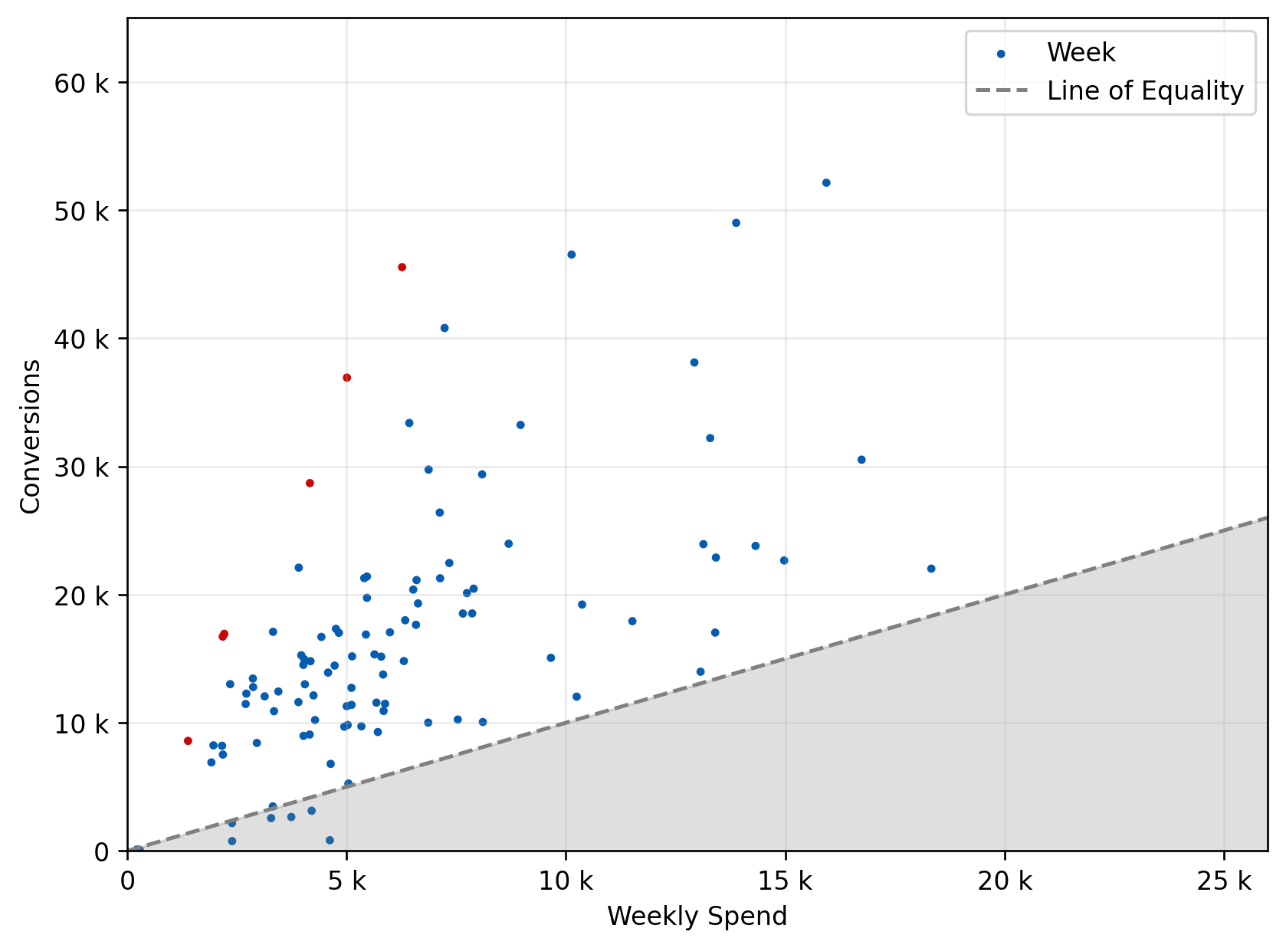
Attendance Conversions by weekly SEM spend
Relationship between the dollar amount spent & the number of attendance conversions for each week.
Notes:
Shaded area is where conversion rate < 100%
Midpoint conversion/cost = 2.1
Campaigns of less efficiency:
  The Beekeeper IMAX
  Aquaman 2
  Ghost Busters: Frozen Empire
Campaigns of more efficiency:
  Junxion (Erin Mills, Kildonian)
  Masterbrand Loyalty Relaunch
  Super Mario Bros.
  Dungeons & Dragons: Honor Among Thieves
Weeks highlighted in red have the highest conversion per dollar spent
Highlighted weeks include Barbie and Oppenheimer
2023-07-21
2023-07-28
Area of Inefficiency
*Data covers Q2 2023 to Q1 2025
*Data does not consider external factors such as weather, holidays
Conversion Campaigns

Slide 21
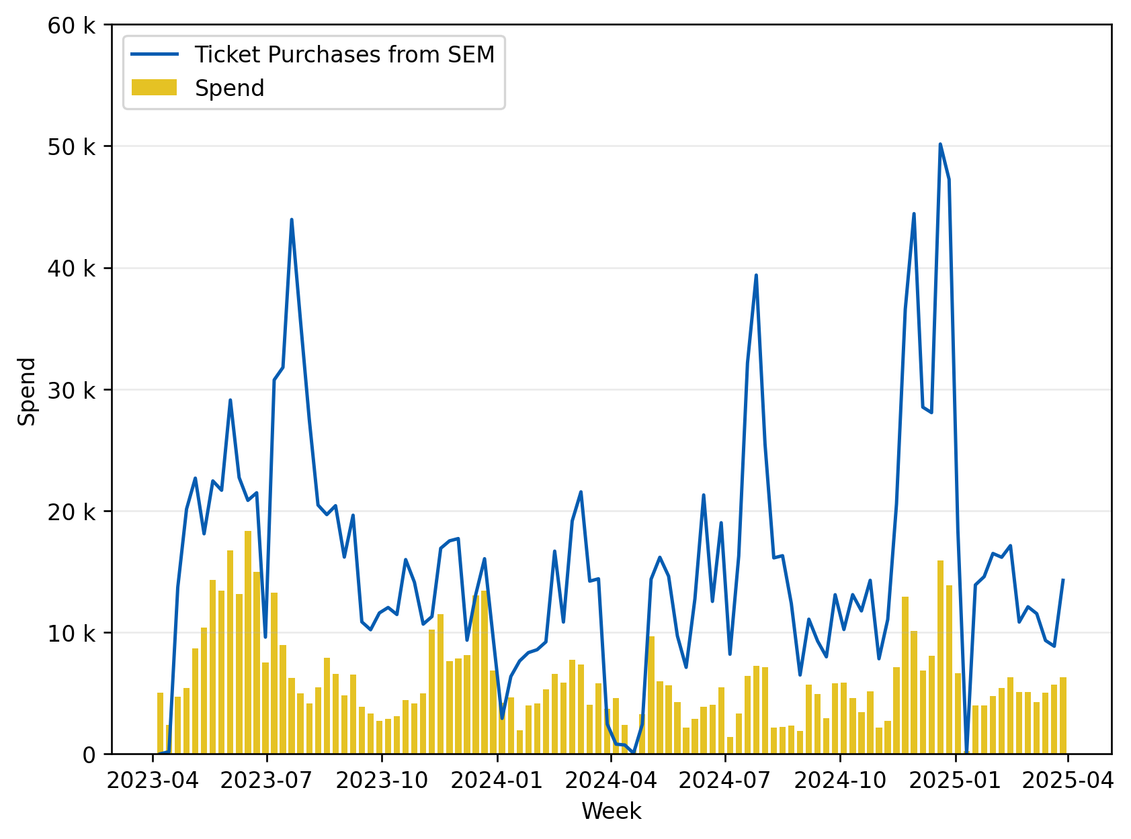
SEM Spend vs attributable ticket purchases by week
Association between the dollar amount spent vs the number of ticket purchases for each week in the SEM channel
Notes:
Correlation coefficient = 0.60
  Positive relationship between spend amount and ticket purchases
  In general, more marketing spend leads to more ticket sales
Lots of fluctuation observed
  Impacted by uncontrollable factors such as releasing films
  Seasonality exists
*Data covers Q2 2023 to Q1 2025
*Data does not consider external factors such as weather, holidays
Conversion Campaigns

Slide 22
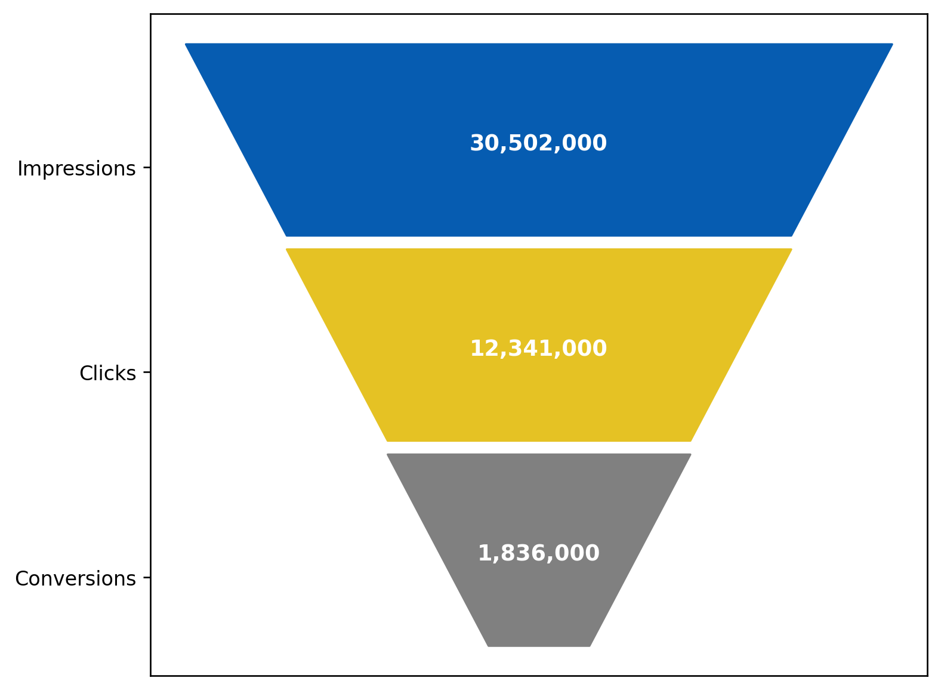
SEM customer journey
Breakdown of cumulative impressions, clicks, and conversions from SEM campaigns.
Around 40% of impressions turn into clicks (click-through rate)
Roughly 15% of those clicks turn into conversions (conversion rate)
6% of all impressions turn into conversions
*Data covers Q2 2023 to Q1 2025
*Data does not consider external factors such as weather, holidays

Slide 23
meta
Notes:
10:00

Slide 24
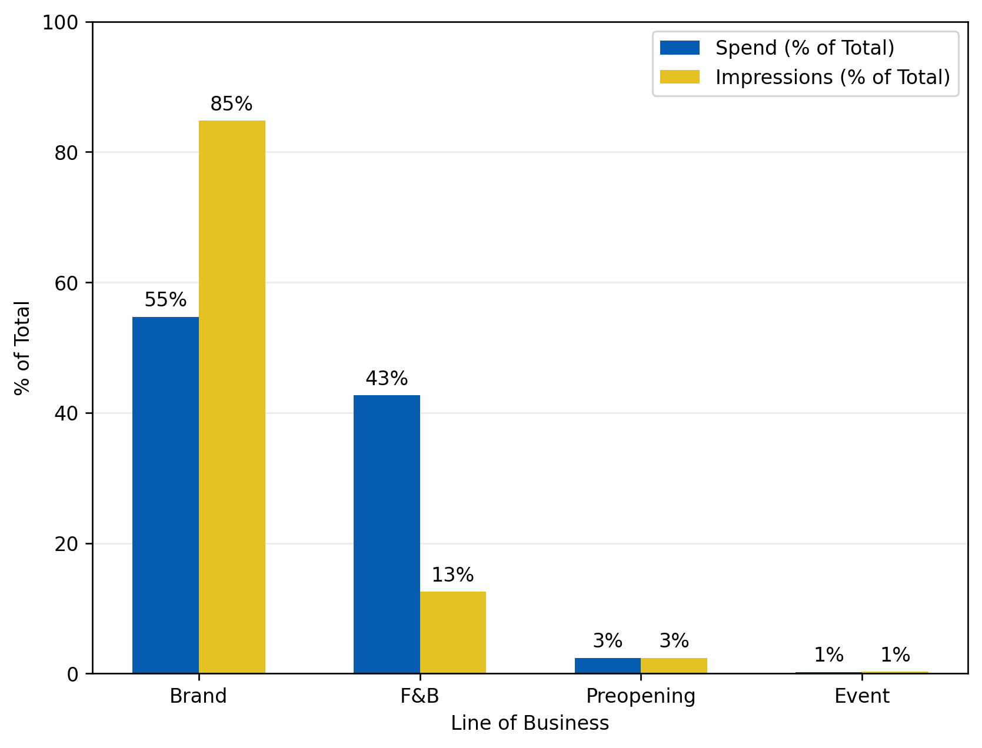
Meta Spend by LOB vs impressions
Comparison of where budget is allocated vs where actual impressions are generated across the lines of business in the Meta channel with the purpose of customer awareness increase.
F&B includes campaigns nationwide for alcohol awareness
Preopening includes one campaign for Junxion Erin Mills announcements
*Data covers Q2 2023 to Q1 2025
*Data does not consider external factors such as weather, holidays
Awareness Campaigns

Slide 25
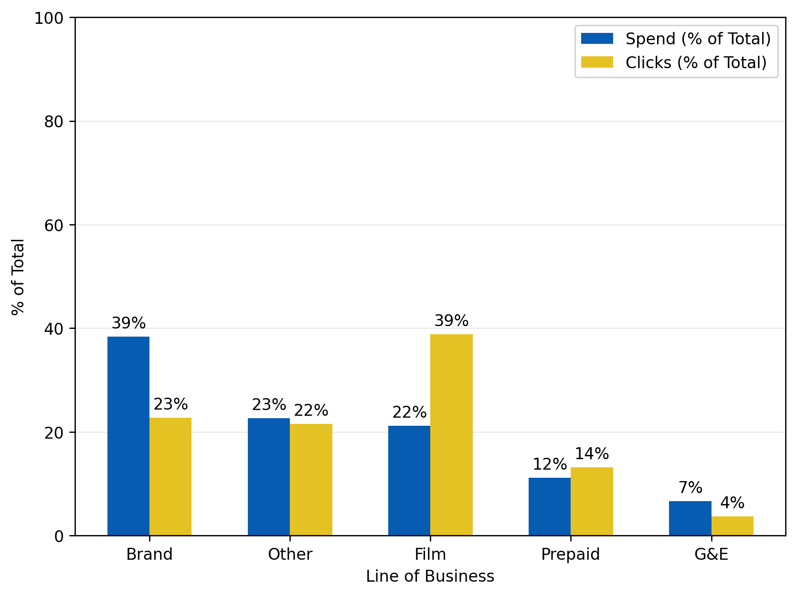
Meta Spend by LOB vs CLicks
Comparison of where budget is allocated vs where actual clicks are generated across the lines of business in the Meta channel with the purpose of customer consideration increase.
Notes:
High efficiency in Film campaigns
Overspend in Brand, G&E relative to engagement
“Other” includes:
  Exhibition
  Gaming
  Pictures
*Data covers Q2 2023 to Q1 2025
*Data does not consider external factors such as weather, holidays
Consideration Campaigns

Slide 26
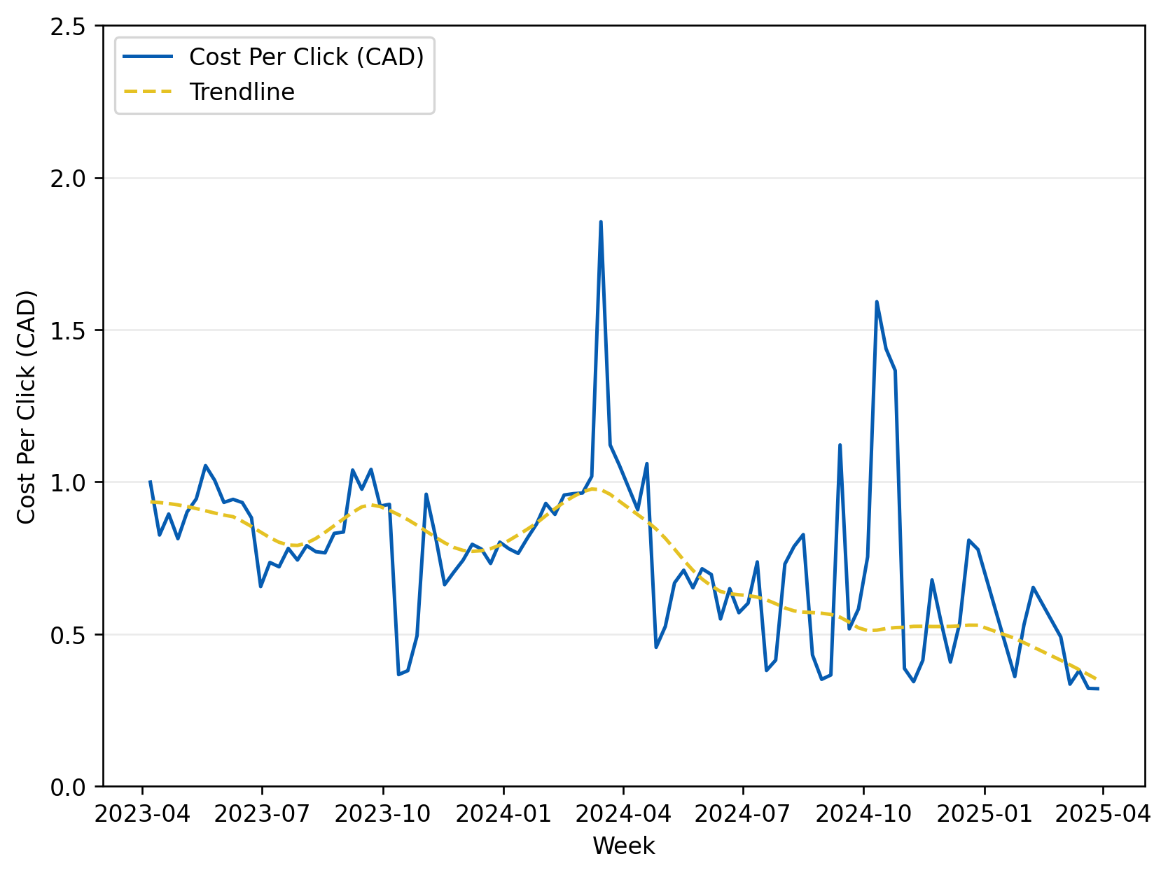
Meta COST PER CLICK By week
Trend line for the cost per click.
Cost per click = the dollar amount spent for each click acquired each week.
Notes:​
Overall, cost per click is gradually decreasing, which is a positive sign
Period of highest return: Q3 2024
Period of lowest return: Q4 2023
Least Efficient Campaigns:
  The Color Purple
  Marvels
  The Exorcist
Most Efficient Campaigns:
  Deadpool & Wolverine
  Joker: Folie A Deux
Performance mostly film-dependant
*Data covers Q2 2023 to Q1 2025
*Data does not consider external factors such as weather, holidays
Consideration Campaigns

Slide 27
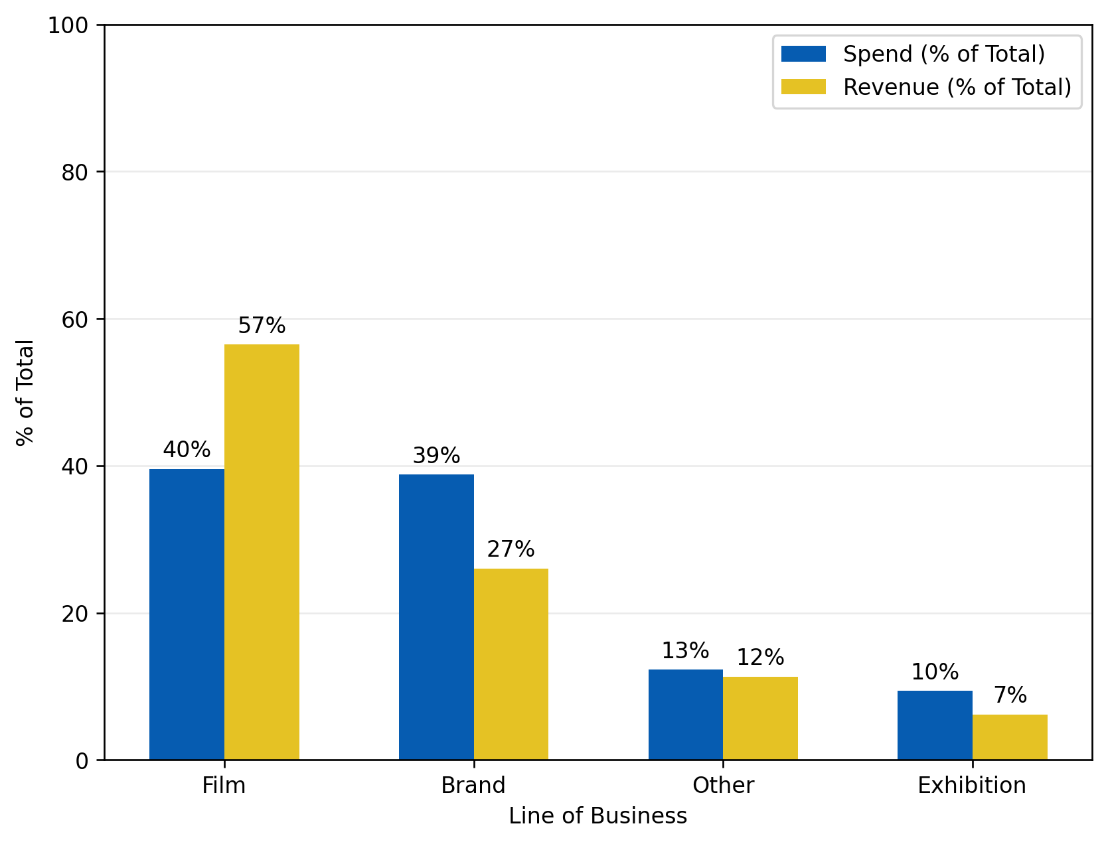
Meta Spend LOB vs Revenue
Comparison of where budget is allocated vs where revenue is generated across the lines of business in the Meta channel with the purpose of customer purchase increase.
Notes:
High efficiency in Film campaigns
Overspend in Brand, Exhibition relative to engagement
“Other” includes:
  Event Cinema
  Cineclub
  IMAX
*Data covers Q2 2023 to Q1 2025
*Data does not consider external factors such as weather, holidays
Conversion Campaigns

Slide 28
snapchat
Notes:
13:00

Slide 29
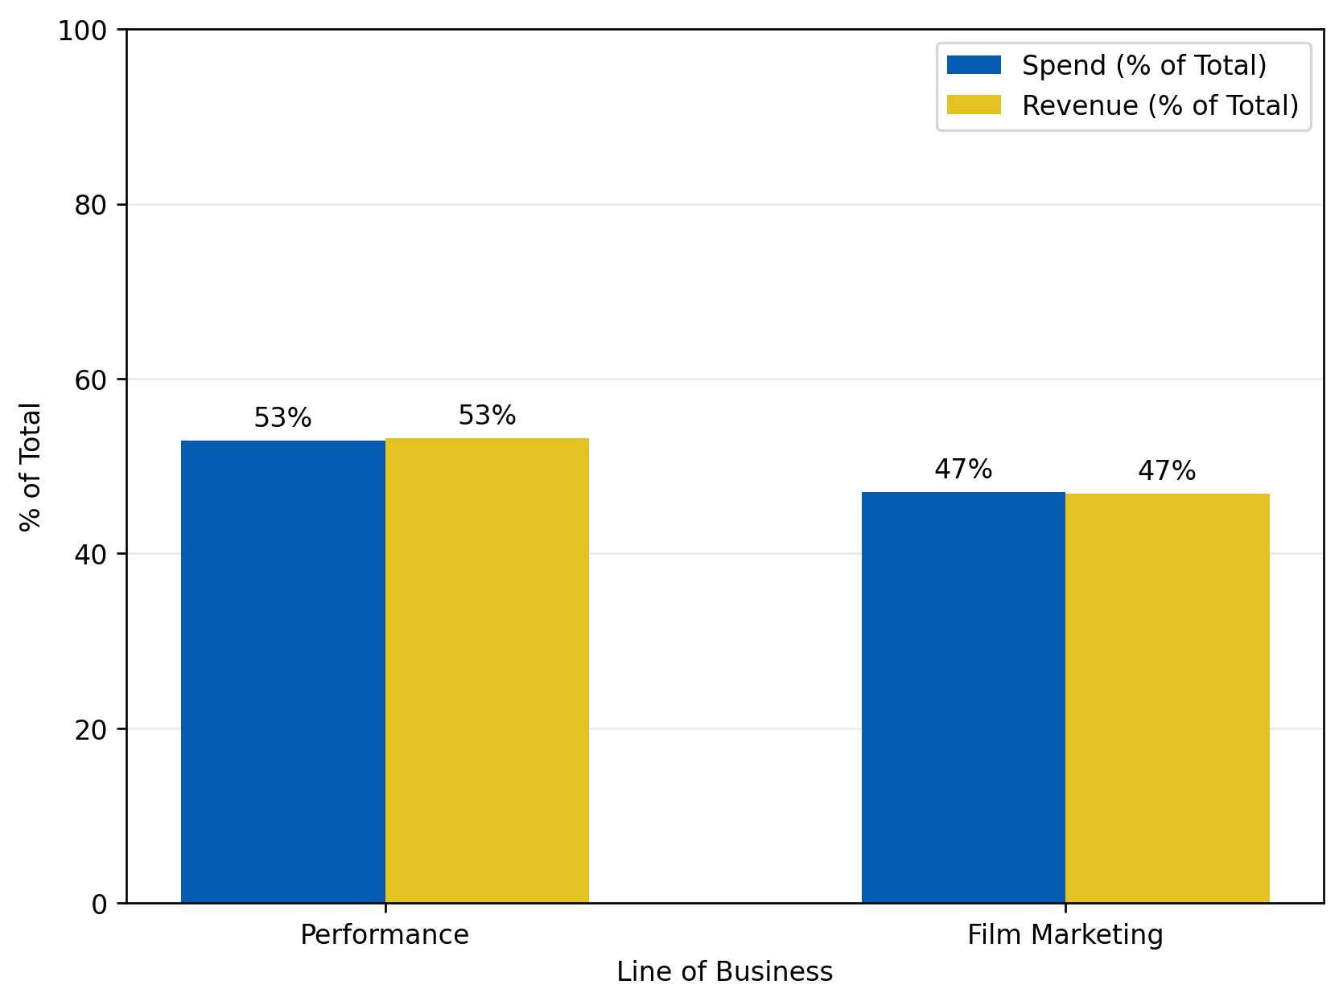
SNAPCHAT Spend by lob vs Revenue
Comparison of where budget is allocated vs where revenue is generated across the lines of businesses in the Snapchat channel with the purpose of attendance conversion increase.
Notes:
Performance generally has higher budget allocation and higher revenue in return
Both lines of business roughly have similar proportions in investments and revenue
Indicates efficiency in current spend
*Data covers Q2 2023 to Q1 2025
*Data does not consider external factors such as weather, holidays
Conversion Campaigns

Slide 30
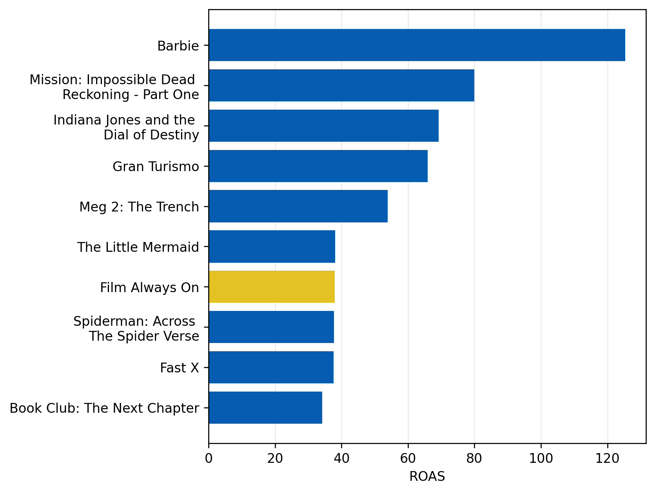
ROAS by snapchat CAMPAIGN
Revenue return per dollar spent on each advertisement campaign. The chart displays the top 10 campaigns by ROAS.
Notes:
Maximum ROAS is around $120 from Barbie
Using the "Always On" campaign as a benchmark, 6 campaigns had superior performance
Around $40 ROAS is observed to be the point of transition to "efficiency"
*Data covers Q2 2023 to Q1 2025
*Data does not consider external factors such as weather, holidays
Conversion Campaigns

Slide 31
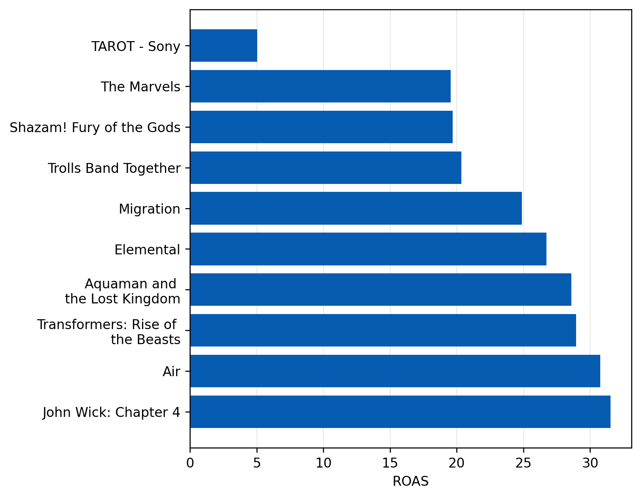
ROAS by snapchat CAMPAIGN
Revenue return per dollar spent on each advertisement campaign. The chart displays the bottom 10 campaigns by ROAS.
Notes:
TAROT film campaign lowest performing with ROAS = 5
Followed by The Marvels and Shazam! Fury of the Gods
Bottom 3 campaigns had a ROAS of below 20
*Data covers Q2 2023 to Q1 2025
*Data does not consider external factors such as weather, holidays
Conversion Campaigns

Slide 32
tiktok
Notes:
14:00

Slide 33
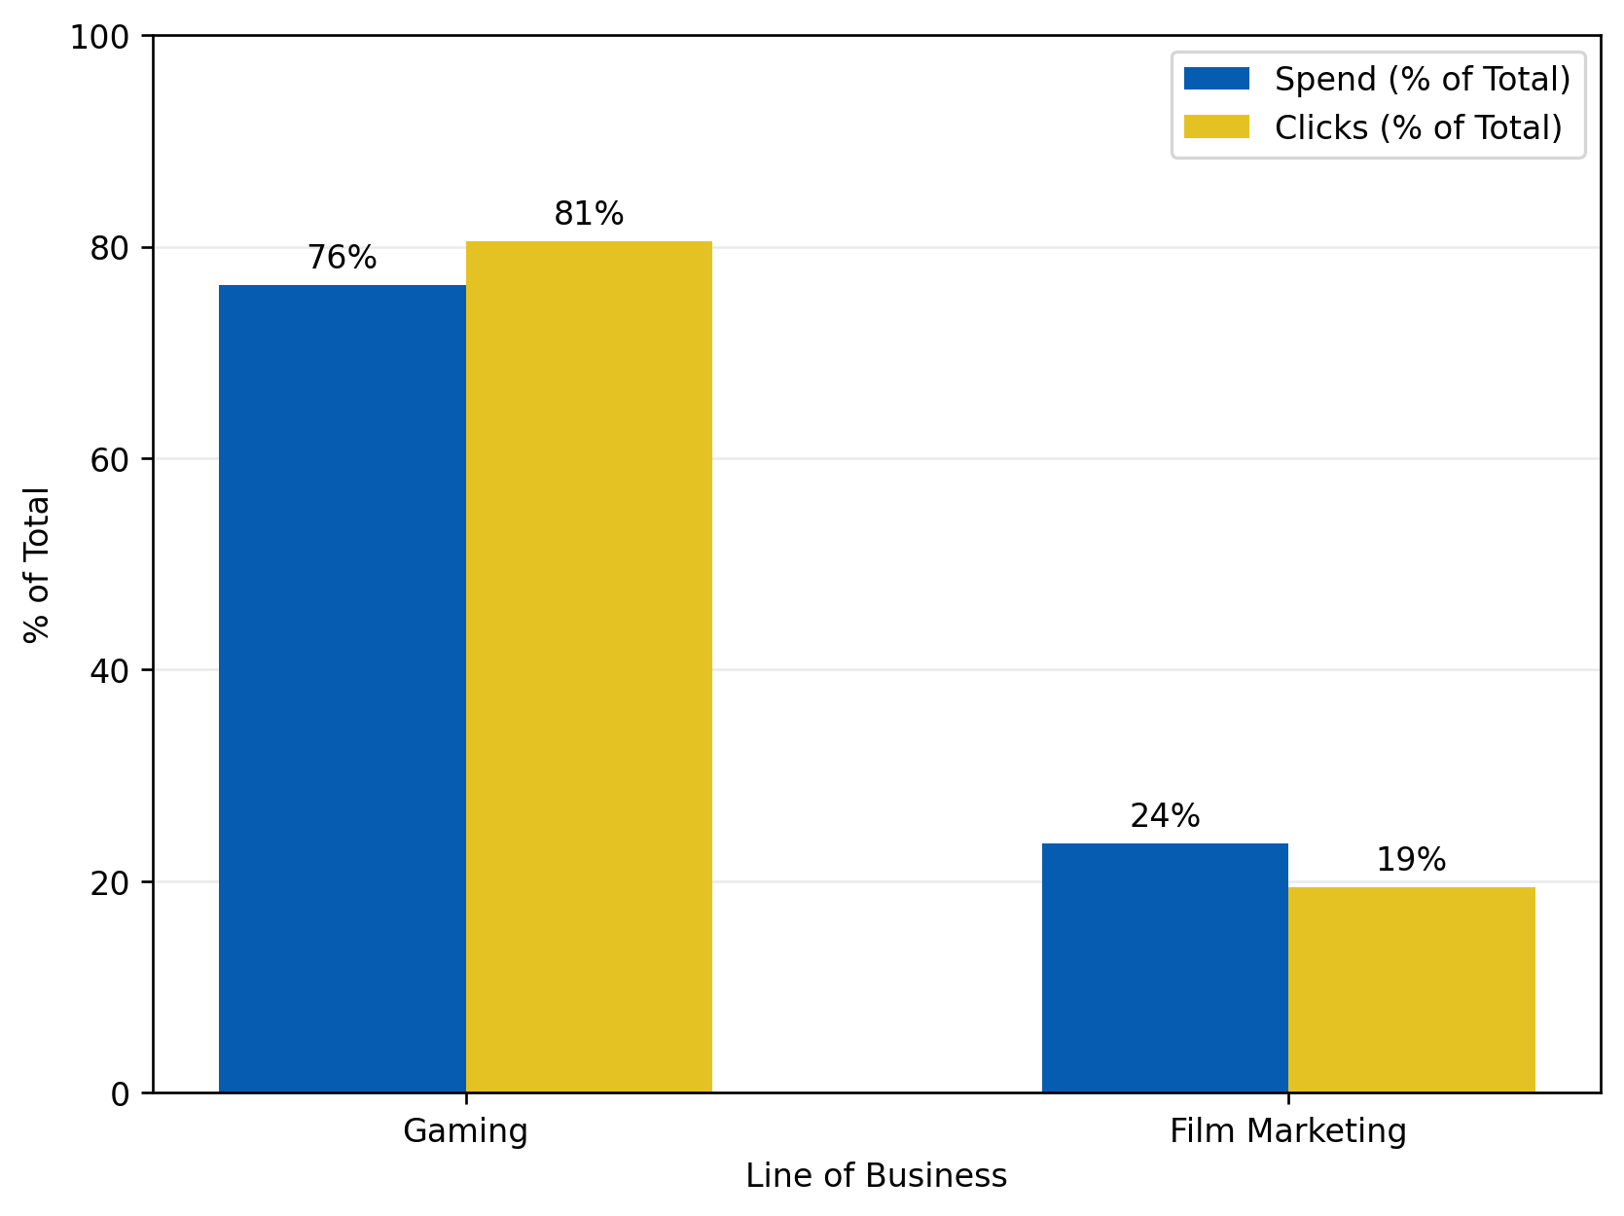
Tiktok Spend by lob vs CLicks
Comparison of where budget is allocated vs where actual clicks are generated across the lines of businesses in the TikTok channel with the purpose of customer consideration increase.
Notes:
Gaming generally has higher budget allocation and higher click conversion in return
Gaming shows higher click conversion proportion relative to the investment proportion
Film marketing shows lower click conversion proportion relative to the investment proportion
Gaming is observed to be the more efficient choice, also being the current major line of business
*Data covers Q2 2023 to Q1 2025
*Data does not consider external factors such as weather, holidays
Consideration Campaigns

Slide 34
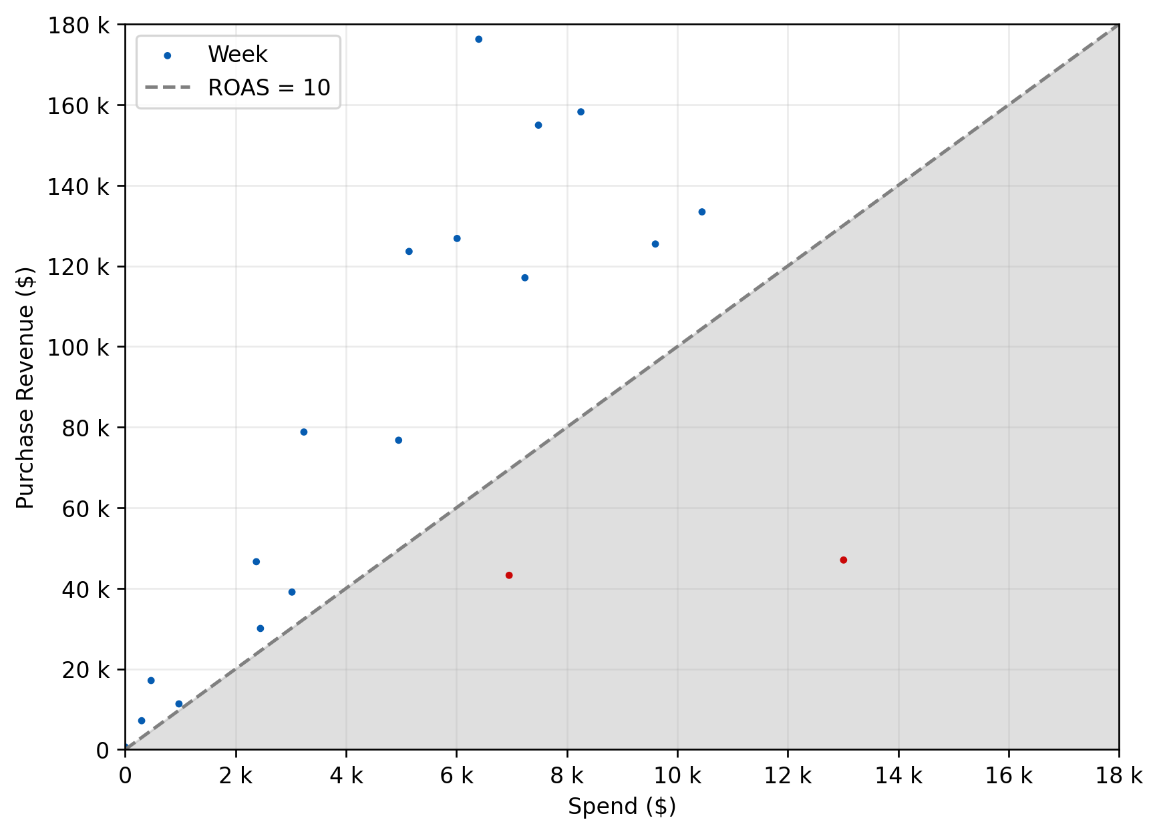
Tiktok Weekly Spend vs PURCHASE Revenue
Relationship between the dollar amount spent & the revenue attributable to purchases for each week.
Notes:
TikTok channel only includes one LOB: Film Marketing
Shaded area is where ROAS < 10
Correlation = 0.68
  Moderate to strong relationship between spend and revenue
  In general, more marketing spend leads to higher revenue earned.
2024-05-03
2024-04-26
*Data covers Q2 2023 to Q1 2025
*Data does not consider external factors such as weather, holidays
Conversion Campaigns

Slide 35
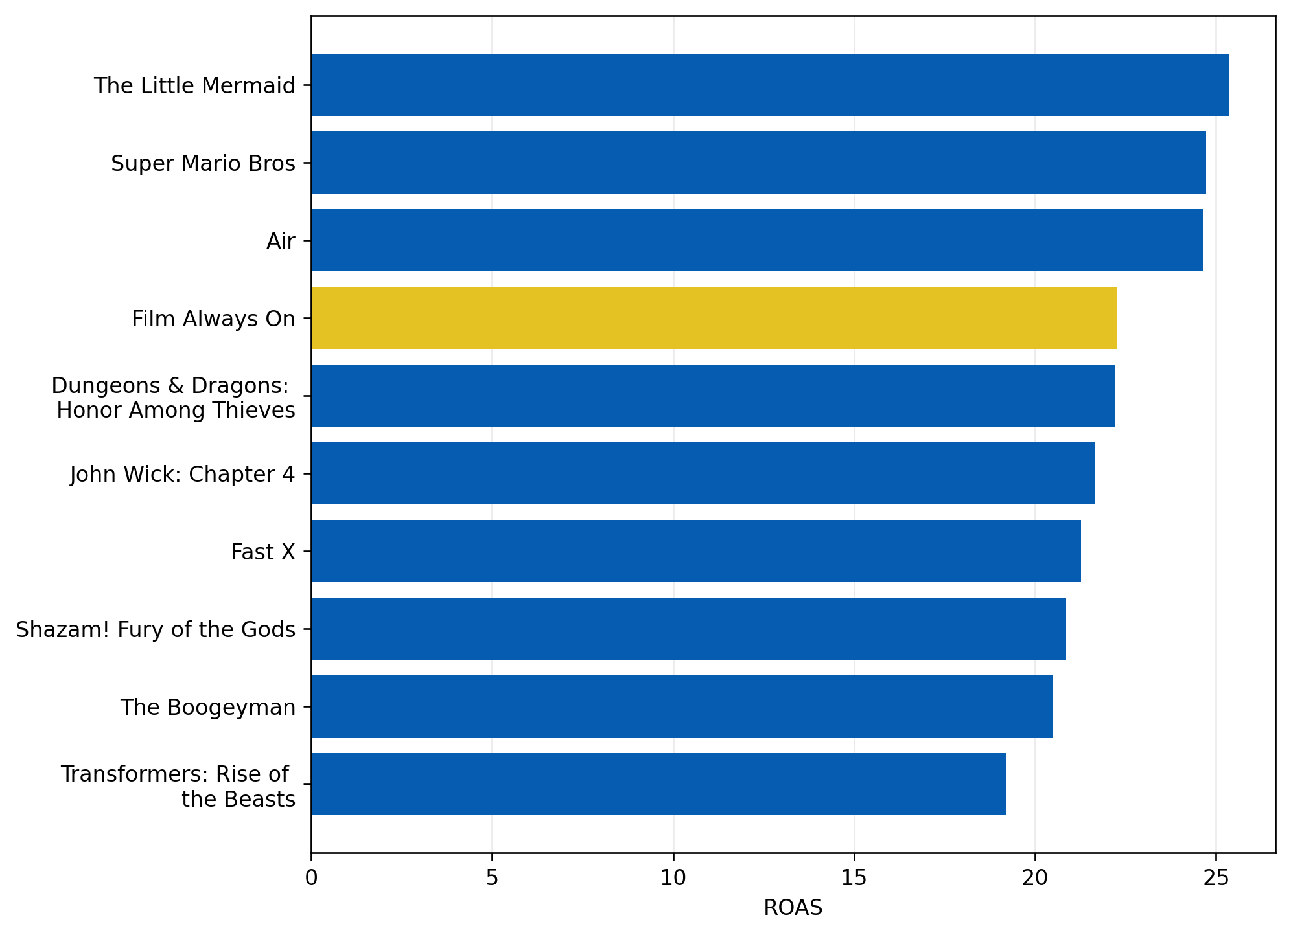
ROAS by tiktok CAMPAIGN
Revenue return per dollar spent on each advertisement campaign. The chart displays the top 10 campaigns by ROAS.
Notes:
Maximum ROAS is 40 from The Little Mermaid (compared to 120 from Snapchat)
Using the "Always On" campaign as a benchmark, 3 campaigns had superior performance
Around 25 ROAS is observed to be the point of transition to "efficiency"
Snapchat is observed to be the relatively optimal channel over TikTok
*Data covers Q2 2023 to Q1 2025
*Data does not consider external factors such as weather, holidays
Conversion Campaigns

Slide 36
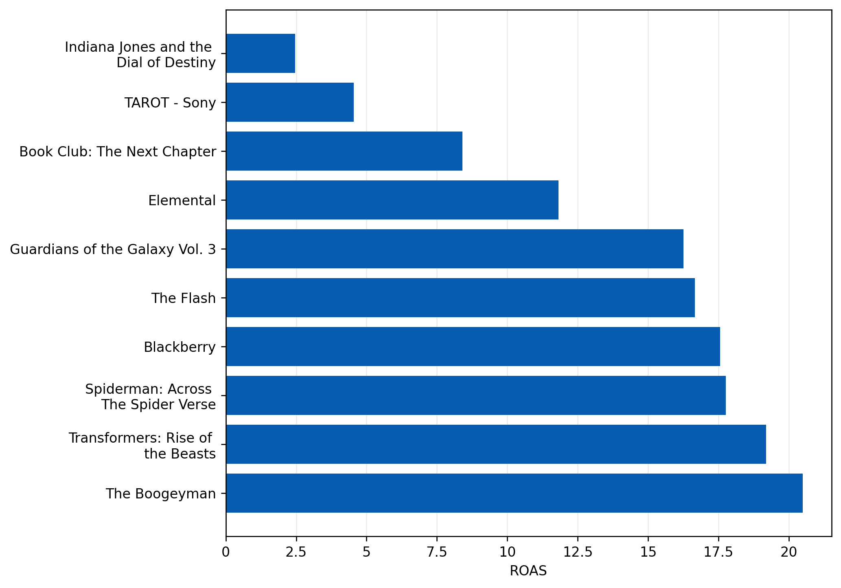
ROAS by tiktok CAMPAIGN
Revenue return per dollar spent on each advertisement campaign. The chart displaysthe bottom 10 campaigns by ROAS.
Notes:
Indiana Jones and the Dial of Destiny lowest performing with ROAS = 2.5
Followed by TAROT and Book Club 2
*Data covers Q2 2023 to Q1 2025
*Data does not consider external factors such as weather, holidays
Conversion Campaigns

Slide 37
programmatic
Notes:
16:00

Slide 38
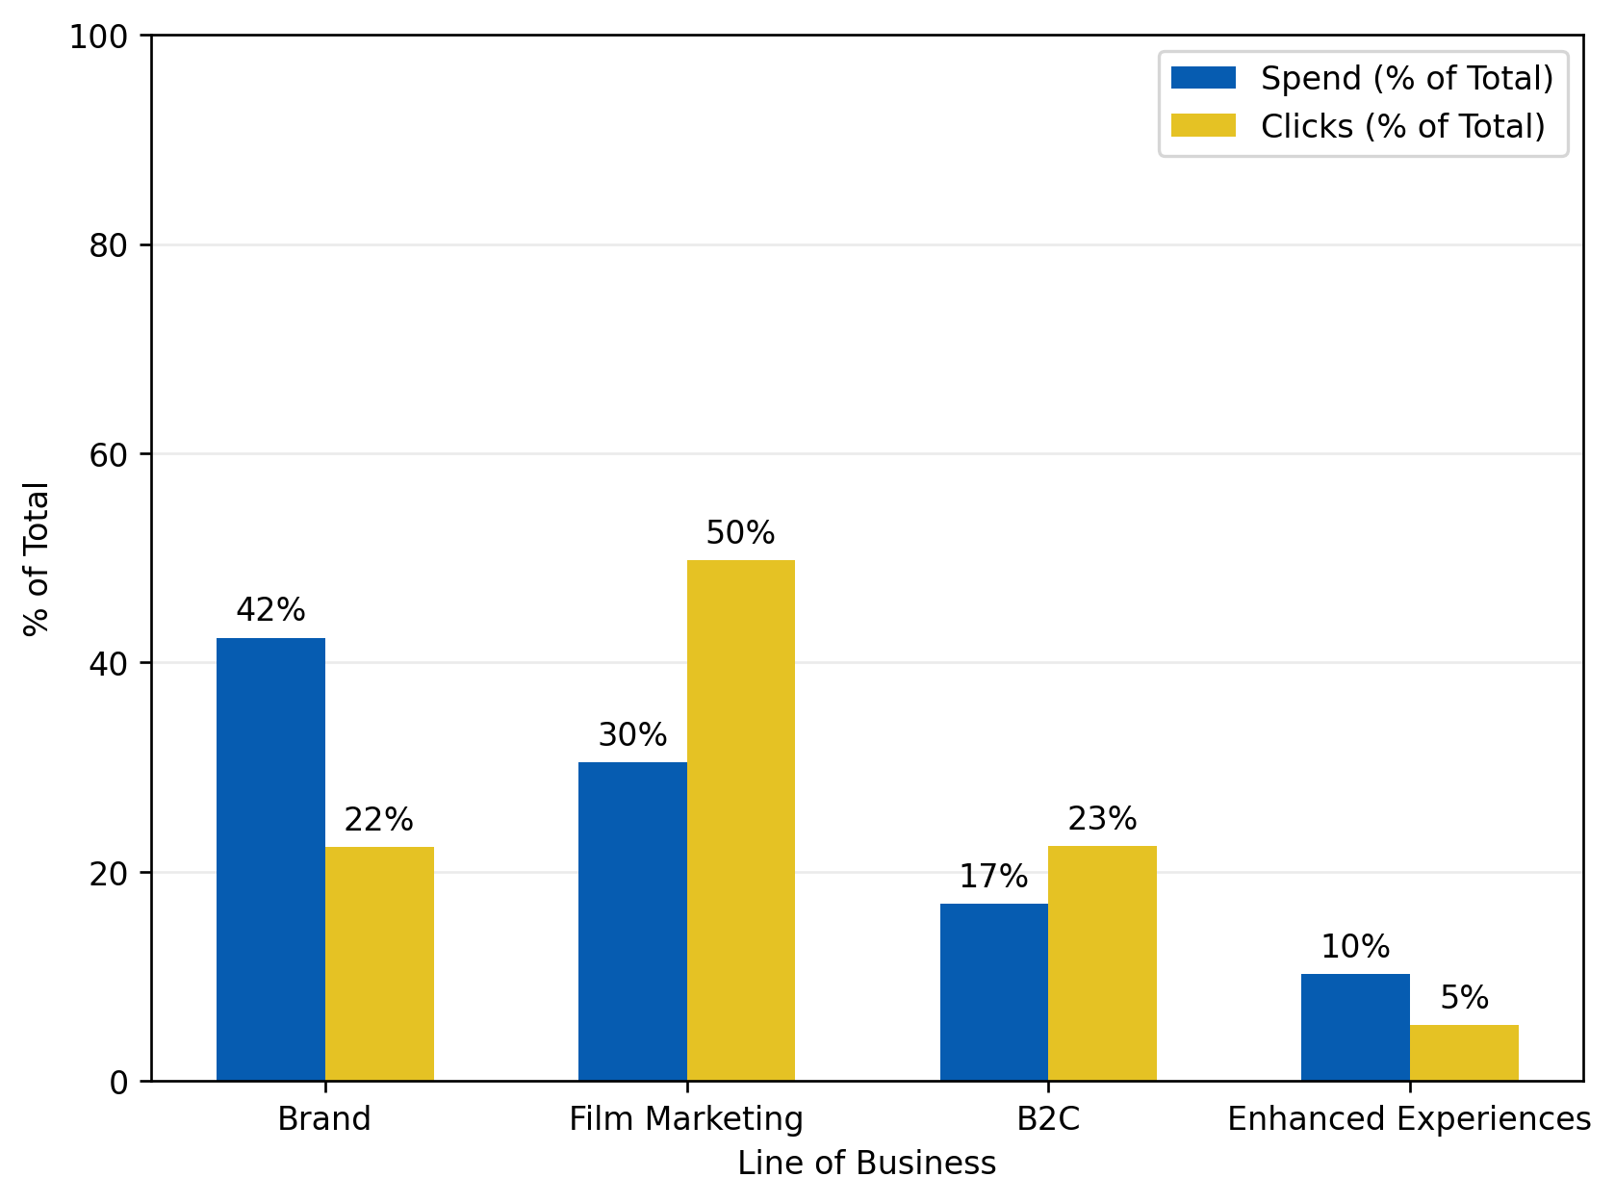
Programmatic spend by lob vs clicks
Comparison of where budget is allocated vs where actual clicks are generated across the lines of businesses in the Programmatic channel with the purpose of customer consideration increase.
Notes:
Film marketing generates the highest proportion of clicks relative to the investment proportion
B2C is the other line of business that generates a higher proportion of clicks relative to its investment
Brand and Enhanced Experiences generate less clicks relative to its investment, hence making them inefficient
Brand has highest investment proportion but second lowest click generation
Observing that film marketing was inefficient in the TikTok channel, the performance of business lines depend on the channel
*Data covers Q2 2023 to Q1 2025
*Data does not consider external factors such as weather, holidays
Consideration Campaigns

Slide 39
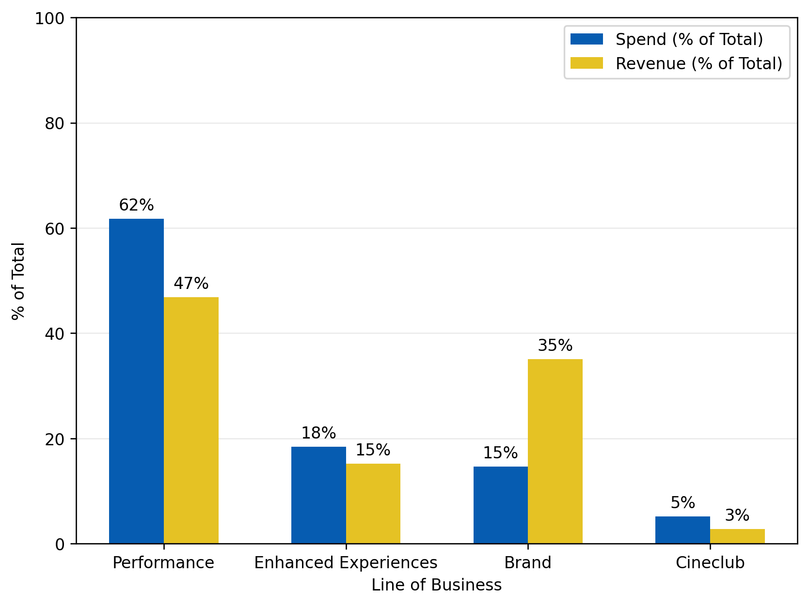
Programmatic spend by lob vs Revenue
Comparison of where budget is allocated vs where revenue is generated across the lines of businesses in the Programmatic channel with the purpose of attendance conversion increase.
Notes:
Brand is observed to be most efficient given the relative revenue generated from the investment
  This contradicts from the consideration efficiency, showing that the performance of business lines is also dependent on the objective
Remaining 3 lines of business are all inefficient, given the relatively low return in revenue
Performance has highest investment proportion with second highest revenue proportion, being the "major" line of business
*Data covers Q2 2023 to Q1 2025
*Data does not consider external factors such as weather, holidays
Conversion Campaigns

Slide 40
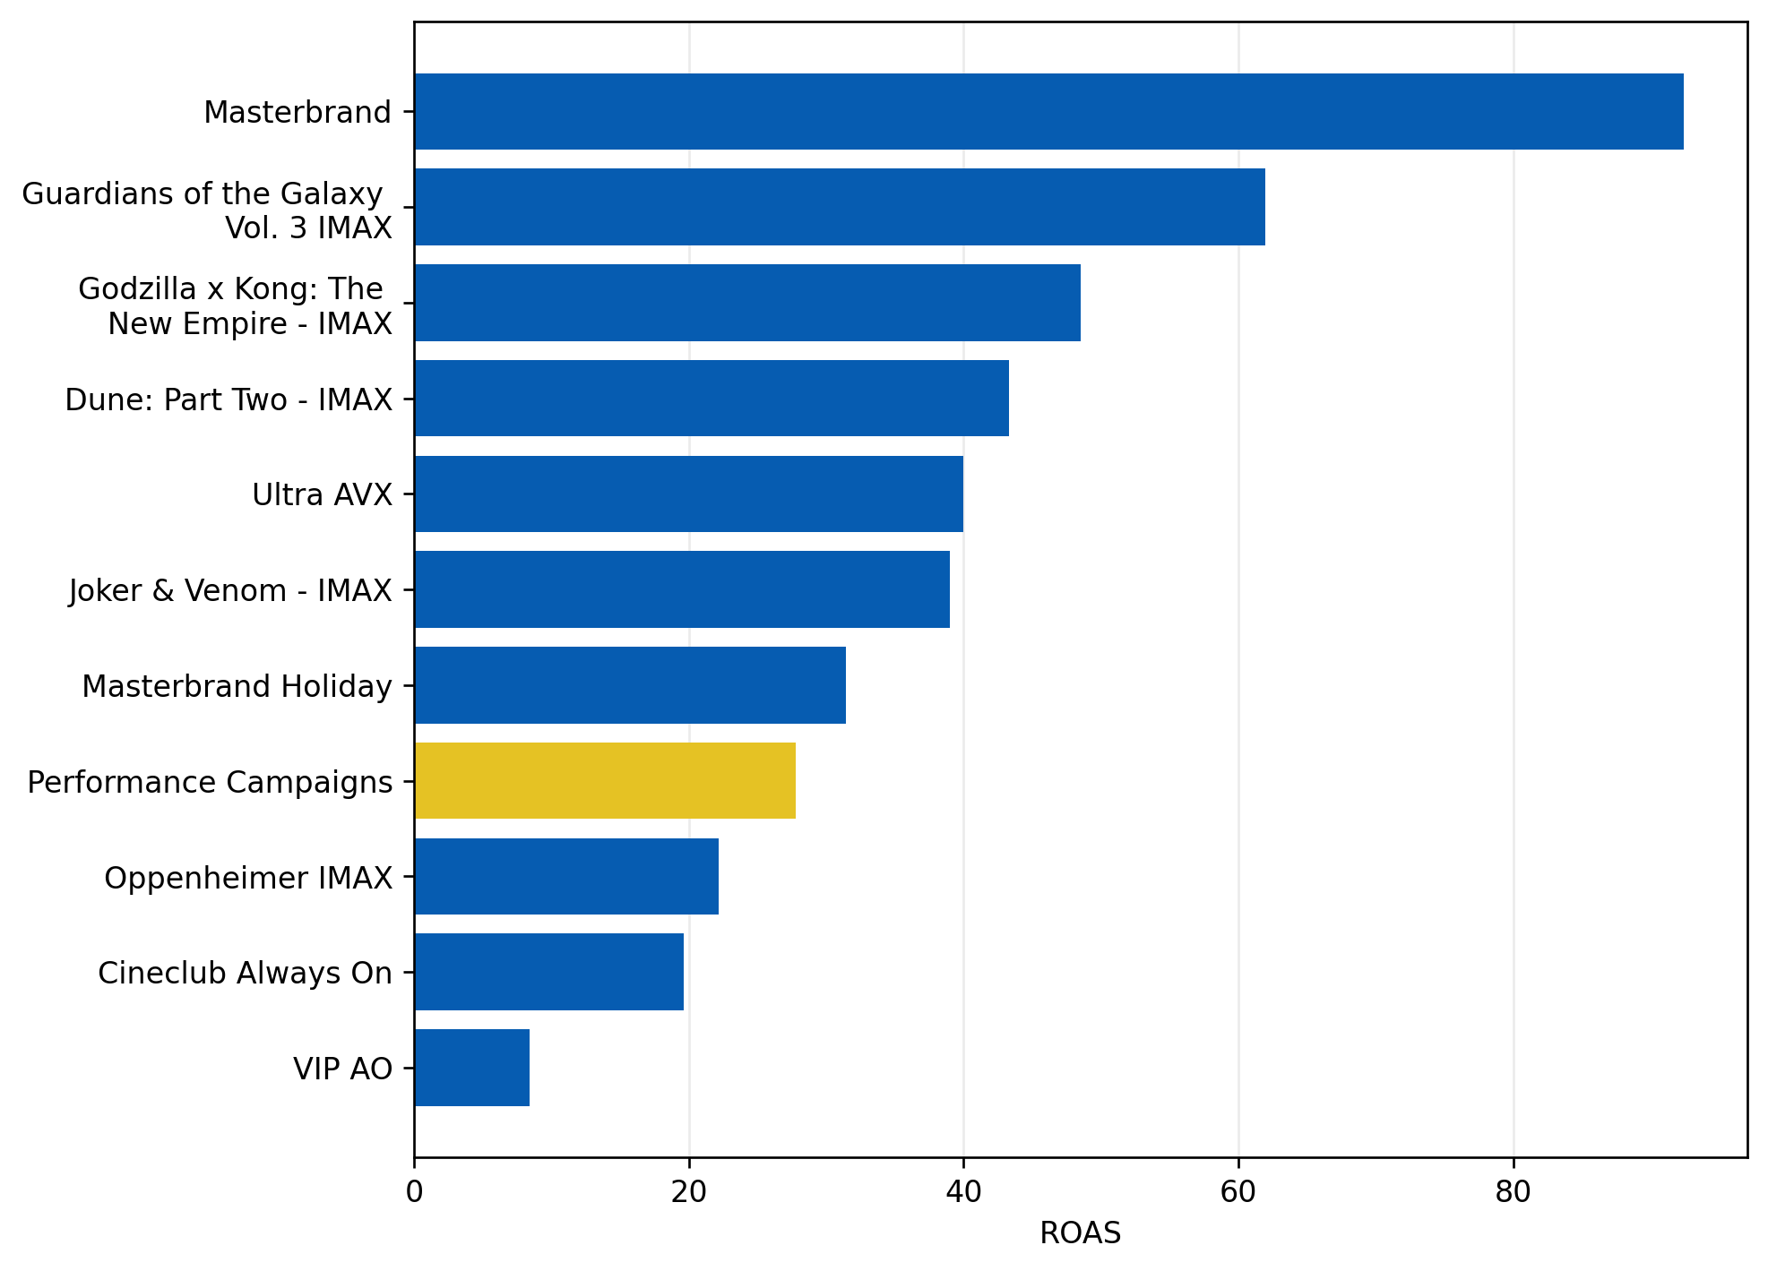
roas by programmatic CAMPAIGN
Revenue return per dollar spent on each advertisement campaign. The left chart displays top 10 campaigns by ROAS.
Notes:
Maximum ROAS is roughly 95 from Masterbrand
Performance had the highest spend among all LOBs.
Masterbrand and Masterbrand Holiday had higher ROAS despite lesser spend.
*Data covers Q2 2023 to Q1 2025
*Data does not consider external factors such as weather, holidays
Conversion Campaigns

Slide 41

programmatic customer journey
Breakdown of cumulative impressions, clicks, and conversions from Programmatic campaigns.
Around 0.2% of impressions turn into clicks (click-through rate)
Roughly 91% of those clicks turn into conversions (conversion rate)
0.2% of all impressions turn into conversions
*Data covers Q2 2023 to Q1 2025
*Data does not consider external factors such as weather, holidays

Slide 42
email
Notes:
18:00

Slide 43
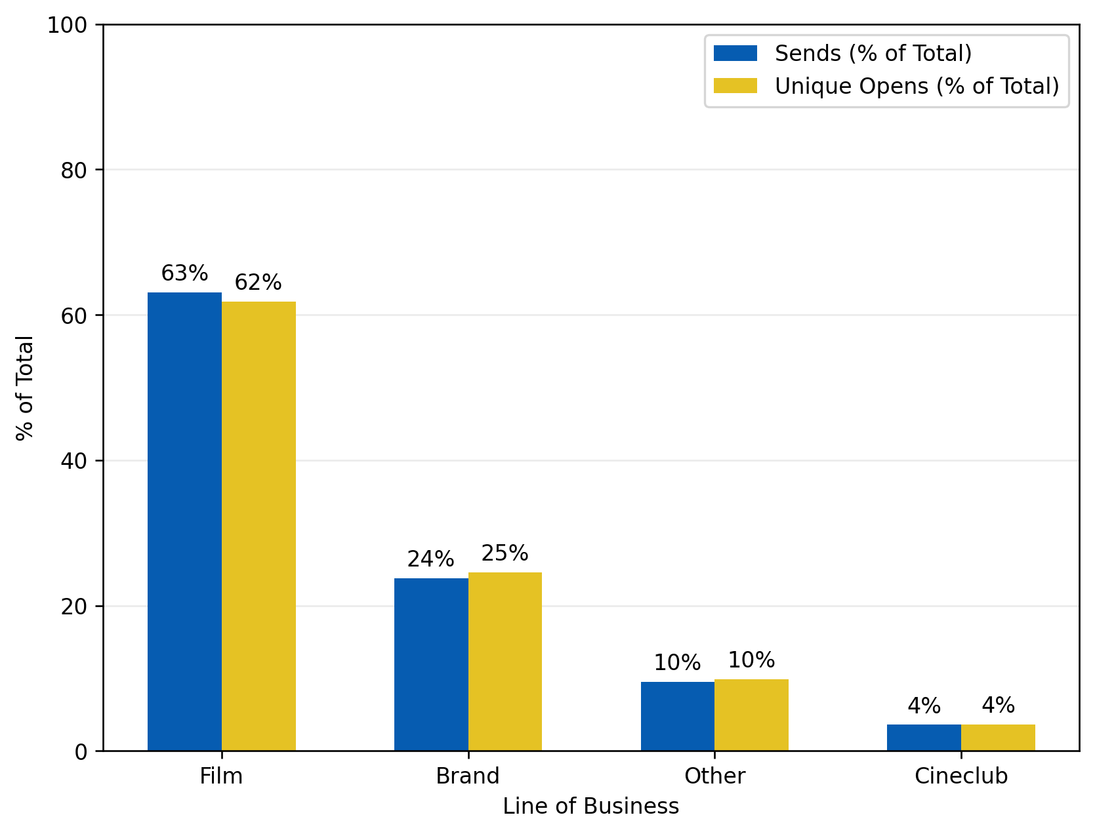
Email Sends by lob vs Unique Opens
Comparison of where email sends are allocated vs where actual email opens are generated across the lines of businesses in the email channel with the purpose of email opens increase.
Notes:
Generally, all lines of business proportionately have similar send and open rates
Film has the most email sends and the most unique email reactions
This is followed by Brand, Other and Cineclub
“Other” includes:
  Store
  Survey
  BM&P
  Scene
*Data covers Q2 2023 to Q1 2025
*Data does not consider external factors such as weather, holidays
Awareness Campaigns

Slide 44

Email SENDS by lob vs Unique CLicks
Comparison of where email sends are allocated vs where actual email clicks are generated across the lines of businesses in the email channel with the purpose of link clicks increase.
Notes:
Film has the most email sends and the most unique email reactions
Brand has relatively more proportional email clicks compared to the proportion of emails sent, making it the efficient line of business
“Other” includes:
  Store
  Survey
  BM&P
  Scene
*Data covers Q2 2023 to Q1 2025
*Data does not consider external factors such as weather, holidays
Consideration Campaigns

Slide 45
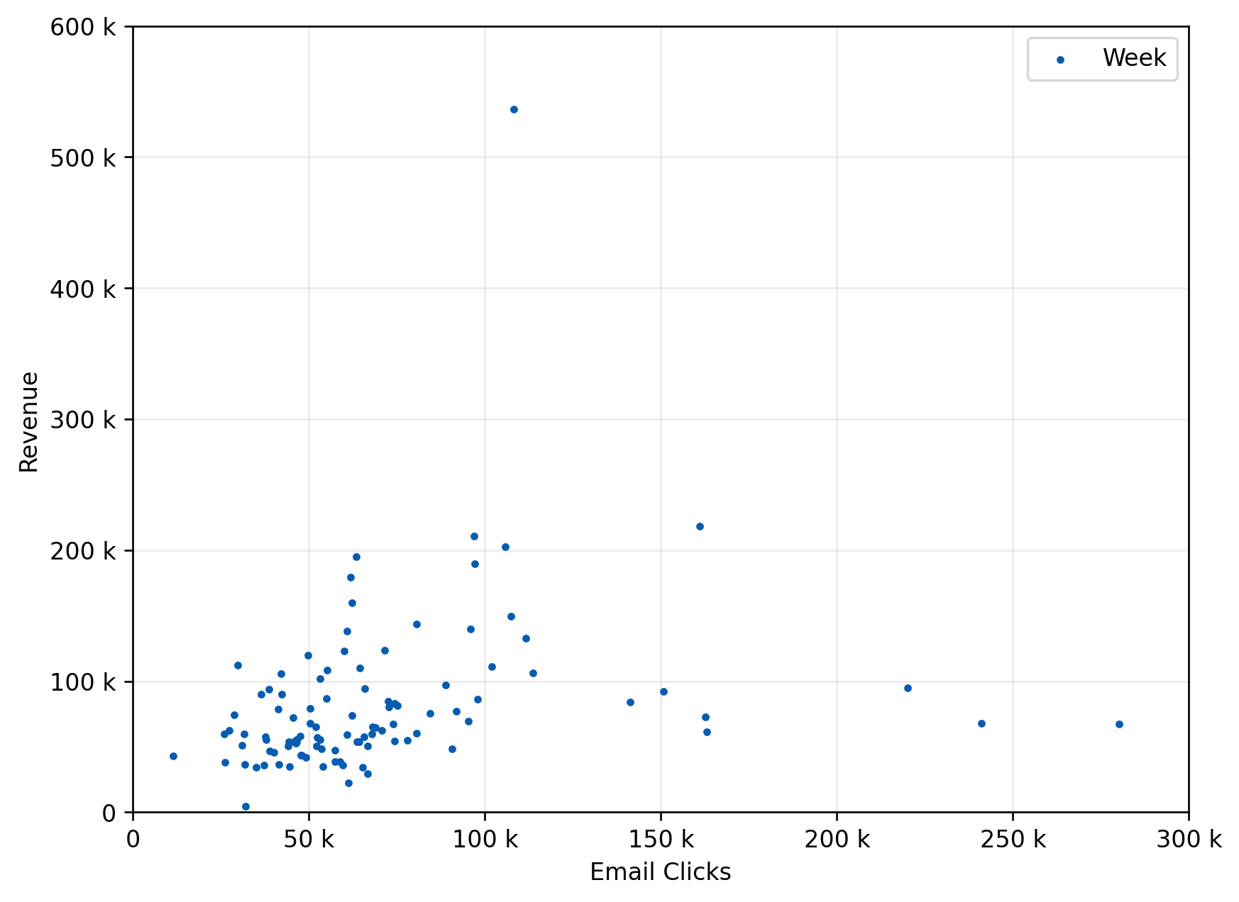
Email clicks vs Revenue
Relationship between the number of email clicks & the revenue attributable to purchases for each week
Notes:
Correlation coefficient = 0.27
  Weak positive relationship between clicks and revenue
  More engagement does not necessarily convert into purchases
Average revenue per click = 1.3
Midpoint revenue per click = 1.1
*Data covers Q2 2023 to Q1 2025
*Data does not consider external factors such as weather, holidays
Conversion Campaigns

Slide 46

email customer journey
Breakdown of cumulative impressions, clicks, and conversions from Programmatic campaigns.
Around 1.5% of impressions turn into clicks (click-through rate)
Roughly 8% of those clicks turn into conversions (conversion rate)
0.1% of all impressions turn into conversions
*Data covers Q2 2023 to Q1 2025
*Data does not consider external factors such as weather, holidays

Slide 47
How to train your channel
Key Takeaways:
SEM consistently delivers the highest ROI at both upper-funnel and lower-funnel, especially strong in Exhibition campaigns.
Programmatic is efficient for awareness and consideration, showing strong ROI and profit with modest spend.
Meta contributes in key areas like Film, but overall spend could be better aligned to performance, especially in Brand and G&E.
TikTok shows selective efficiency, with Gaming outperforming Film for clicks; spend correlates moderately with revenue.
Snapchat warrants further testing to evaluate its role for mid-funnel consideration and incremental reach, especially with younger audiences.
Email continues to drive strong engagement, though its impact on revenue remains modest. Film brings volume, while Brand shows higher click efficiency.

Slide 48
How to train your channel
Strategic Focus:
Scale SEM further, prioritizing high-impact campaigns such as Exhibition AO.
Maintain Programmatic for the upper funnel, prioritizing channels that convert well at lower cost.
Rationalize Meta spend. Focus on Film (C&U) campaigns with demonstrated ROI, monitor overspend in Brand.
Refine TikTok strategy, test Film+Brand tactics further before scaling.
Test Snapchat further to determine its incremental reach, engagement, and cost efficiency.
Continue using Email to build awareness and engagement, while balancing investment with channels that convert more effectively.

Slide 49
Lines of business
Notes:
22:00

Slide 50
lob summary

Slide 51
Lob BUDGET SUMMARY FOR AWARENESS campaigns
2026 Awareness Budget Input (Based on 2024 Actual) |  | $750,000 |  | 2-Year Actual Past Budget |  | $1,507,726
 |  |  |  | Weeks |  | 52
Line of Business | Contribution to Attendance (all factors) | Contribution to Attendance (internal factors only) | Spend Proportion (trailing 2 years) | Actual Yearly Spend (trailing 2-year avg.) | Model-based 2026 Allocation | Model-based 2026 Allocation / week
Brand | 6.3% | 46.7% | 64.1% | $483,085 | $350,000 | $6,731
Cineclub | 2.8% | 20.7% | 1.8% | $13,436 | $155,556 | $2,991
F&B | 1.4% | 10.4% | 10.1% | $75,967 | $77,778 | $1,496
PR | 3.0% | 22.2% | 24.1% | $181,375 | $166,667 | $3,205
Total | 13.5% | 100.0% | 100.0% | $753,863 | $750,000 | $14,423
Awareness campaigns account for ~13.5% of all attendance when factoring in weather, baseline sales, and other external factors.
Brand
Highest spend
Highest attendance contribution
Appropriate budget allocation.
Cineclub
Lowest spend
Average contribution to attendance
Less-than-ideal allocation
Link to worksheet

Slide 52
Lob BUDGET SUMMARY FOR consideration campaigns
2026 Consideration Budget Input (Based on 2024 Actual) |  | $750,000 |  | 2-Year Actual Past Budget |  | $1,489,114
 |  |  |  | Weeks |  | 52
Line of Business | Contribution to Attendance (all factors) | Contribution to Attendance (internal factors only) | Spend Proportion (trailing 2 years) | Actual Yearly Spend (trailing 2-year avg.) | Model-based 2026 Allocation | Model-based 2026 Allocation / week
Brand | 5.8% | 34.9% | 36.6% | $272,422 | $262,048 | $5,039
Enhanced | 0.7% | 4.2% | 1.9% | $14,154 | $31,627 | $608
Exhibition | 1.1% | 6.6% | 7.3% | $54,712 | $49,699 | $956
Film | 1.5% | 9.0% | 5.7% | $42,297 | $67,771 | $1,303
G&E | 1.5% | 9.0% | 21.0% | $156,112 | $67,771 | $1,303
PR | 2.4% | 14.5% | 24.4% | $181,375 | $108,434 | $2,085
Prepaid | 3.6% | 21.7% | 3.2% | $23,484 | $162,651 | $3,128
Total | 16.6% | 100.0% | 100.0% | $744,556 | $750,000 | $14,423
Consideration campaigns account for ~17% of all attendance when factoring in weather, baseline sales, and other external factors.
Brand
Highest spend
Highest attendance contribution
Appropriate budget allocation
Prepaid
Low spend
High attendance contribution
Efficient budget allocation
PR / G&E
High spend
Relatively low attendance contribution
Inefficient budget allocation
Link to worksheet
Notes:
Split social into Snapchat, TikTok, Other

Slide 53
Lob BUDGET SUMMARY FOR conversion campaigns
2026 Conversion Budget Input (Based on 2024 Actual) |  | $1,800,000 |  | 2-Year Actual Past Budget |  | $3,664,365
 |  |  |  | Weeks |  | 52
Line of Business | Contribution to Attendance (all factors) | Contribution to Attendance (internal factors only) | Spend Proportion (trailing 2 years) | Actual Yearly Spend (trailing 2-year avg.) | Model-based 2026 Allocation | Model-based 2026 Allocation / week
Brand | 1.4% | 2.8% | 25.4% | $465,975 | $51,116 | $983
Cineclub | 4.1% | 8.3% | 1.9% | $34,249 | $149,696 | $2,879
Enhanced | 4.5% | 9.1% | 6.4% | $117,300 | $164,300 | $3,160
Event | 1.8% | 3.7% | 1.8% | $32,320 | $65,720 | $1,264
Exhibition | 29.0% | 58.8% | 11.4% | $208,862 | $1,058,824 | $20,362
Film | 2.6% | 5.3% | 29.8% | $546,788 | $94,929 | $1,826
Performance | 3.9% | 7.9% | 13.4% | $245,311 | $142,394 | $2,738
PR | 2.0% | 4.1% | 9.9% | $181,375 | $73,022 | $1,404
Total | 49.3% | 100.0% | 100.0% | $1,832,180 | $1,800,000 | $34,615
Conversion campaigns account for ~49% of all attendance when factoring in weather, baseline sales, and other external factors.
Exhibition
Moderate spend
Highest attendance contribution
Efficient budget allocation
Brand / Film
High spend
Low attendance contribution
Inefficient budget allocation
Link to worksheet
Notes:
Split social into Snapchat, TikTok, Other

Slide 54
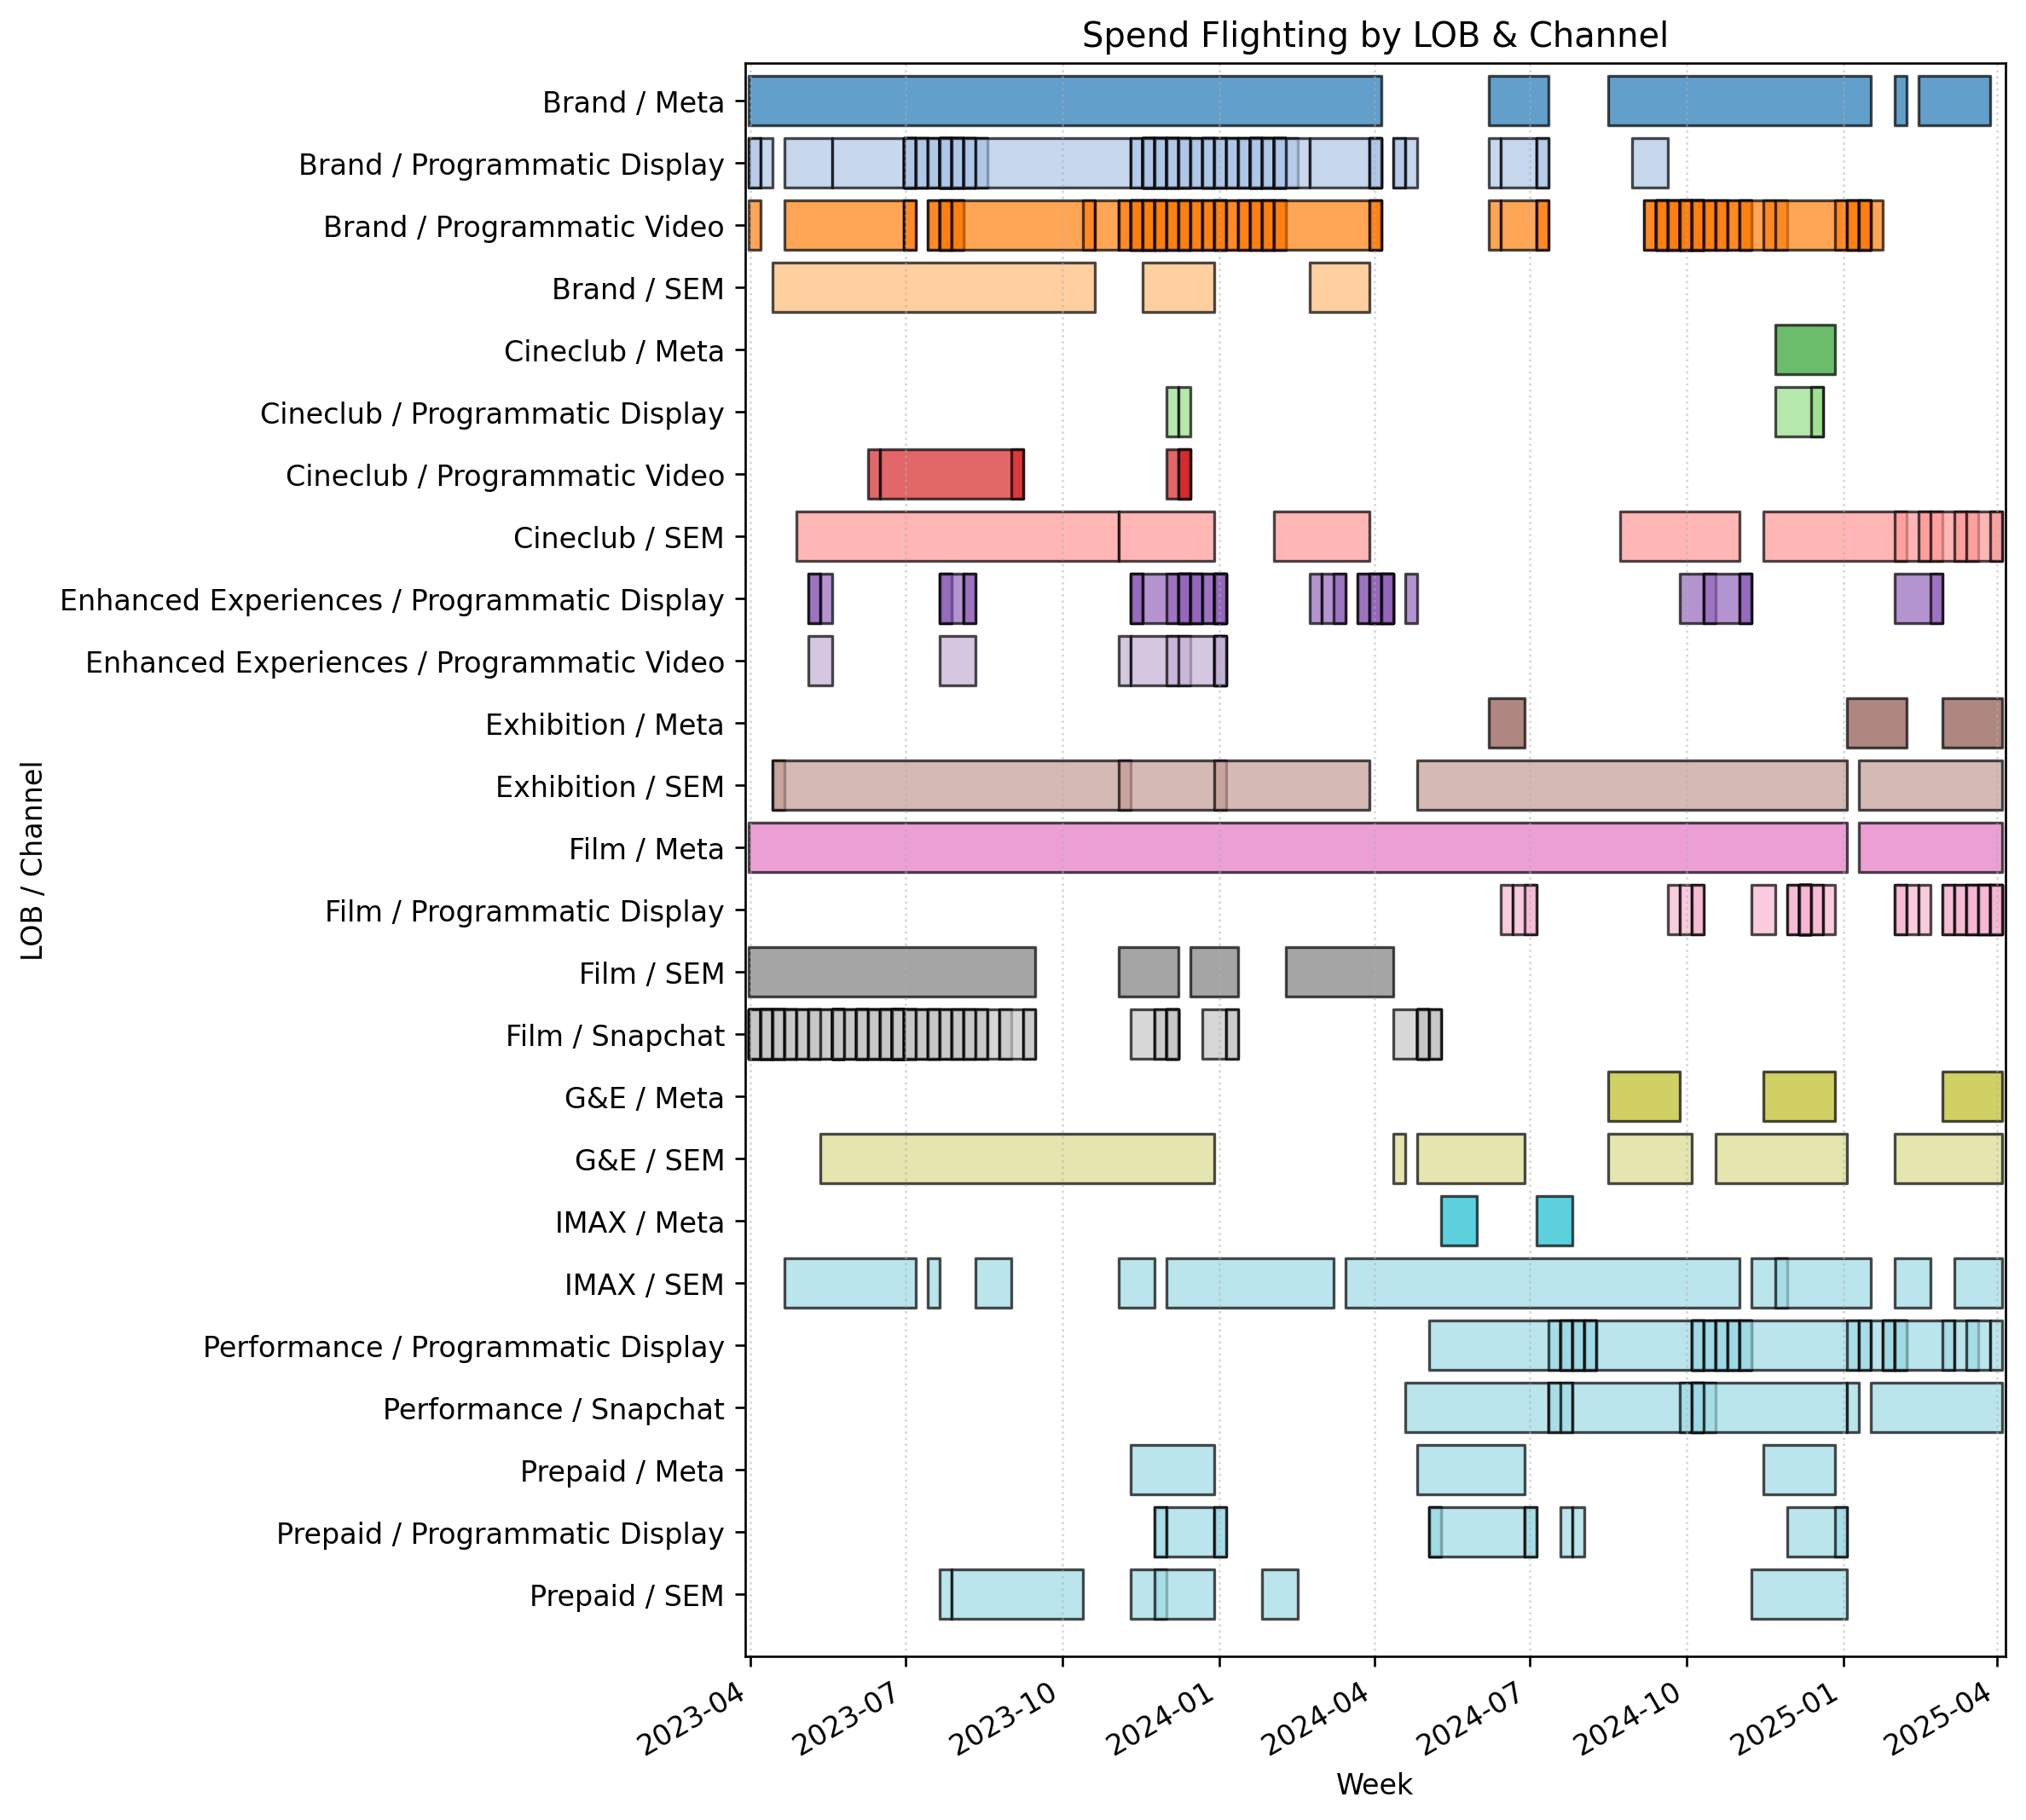
Flighting timeline and recommendations
Overview of LOB/Channel execution cycle, spend and revenue.
Recommendations:
Consistently executed LOBs such as SEM Exhibition, Meta Exhibition, Meta Brand, Meta Film generate highest revenue and customer awareness (Impressions, Clicks)
Newer consistent strategies such as Performance show strong signals with relatively higher revenue and impressions to spend amount
Programmatic display brand has relatively high revenue but hasn’t been utilized in recent years
Film snapchat & SEM also were strong customer awareness drivers, but hasn’t been utilized lately
IMAX generally generates positive revenue regardless of its execution cycle
Recurring strategies such as Prepaid, G&E do generate less revenue but given its relatively low spend and consistent cycle it effectively targets customer awareness (Impressions)

Slide 55
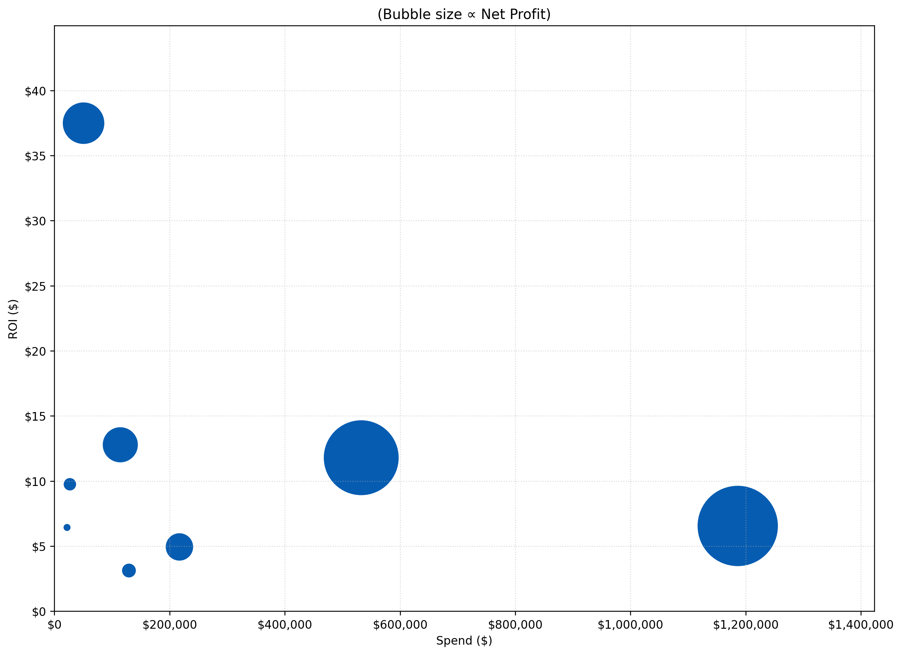
Upper-funnel SPEND, net profit & ROI BY LOB
Summary of LOB spend vs ROI in all awareness and consideration Exhibition campaigns
Bubble size indicates relative net profit
Notes:
IMAX had one of the lowest spend but the highest ROI
Film had more spend but achieved a similar ROI to Enhanced Experiences
G&E lowest ROI among upper-funnel campaigns
Exhibition and Cineclub have smallest spend and profit
IMAX ($2M)
Enhanced Experiences ($1M)
Film ($6M)
Brand ($7M)
Cineclub ($0.2M)
Exhibition
($0.1M)
Prepaid ($0.9M)
G&E ($0.3M)
*Data covers Q2 2023 to Q1 2025
*Data does not consider external factors such as weather, holidays

Slide 56
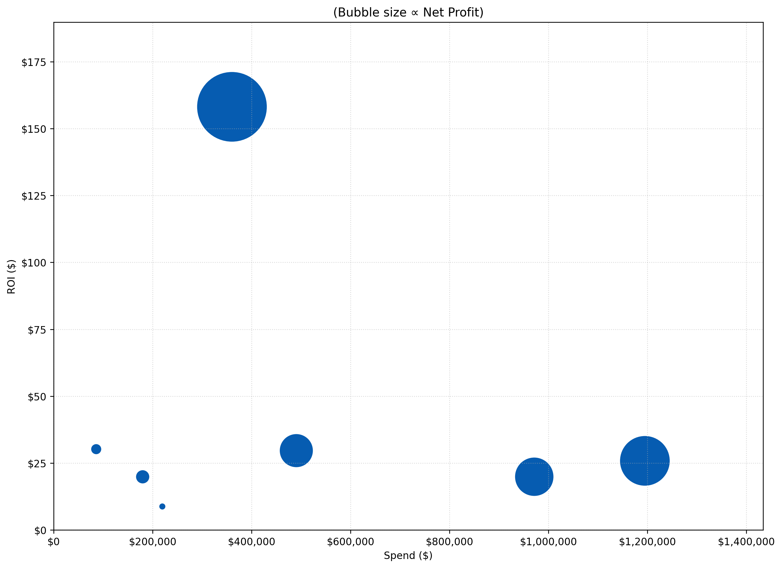
Lower-funnel SPEND, net profit & ROI BY LOB
Summary of LOB spend vs ROI in all conversion Exhibition campaigns
Bubble size indicates relative net profit
Notes:
Exhibition has the highest ROI and highest net profit along with lower spend
Campaigns included in Exhibition:
  Tuesday Promo (006_CP2TNZ3)
  Brand and VIP Always On (001_CP2K790)
  Masterbrand Relaunch (Loyalty and Competitive)
Film and brand have relatively lower ROI compared to allocated spend
Enhanced Experiences, IMAX and Cineclub have smallest impact in terms of allocated spend and profit
Exhibition ($57M)
Enhanced Experiences ($3M)
Film ($30M)
Performance ($14M)
IMAX ($3M)
Brand ($18M)
Cineclub ($2M)
*Data covers Q2 2023 to Q1 2025
*Data does not consider external factors such as weather, holidays

Slide 57
cineclub
Notes:
27:00

Slide 58
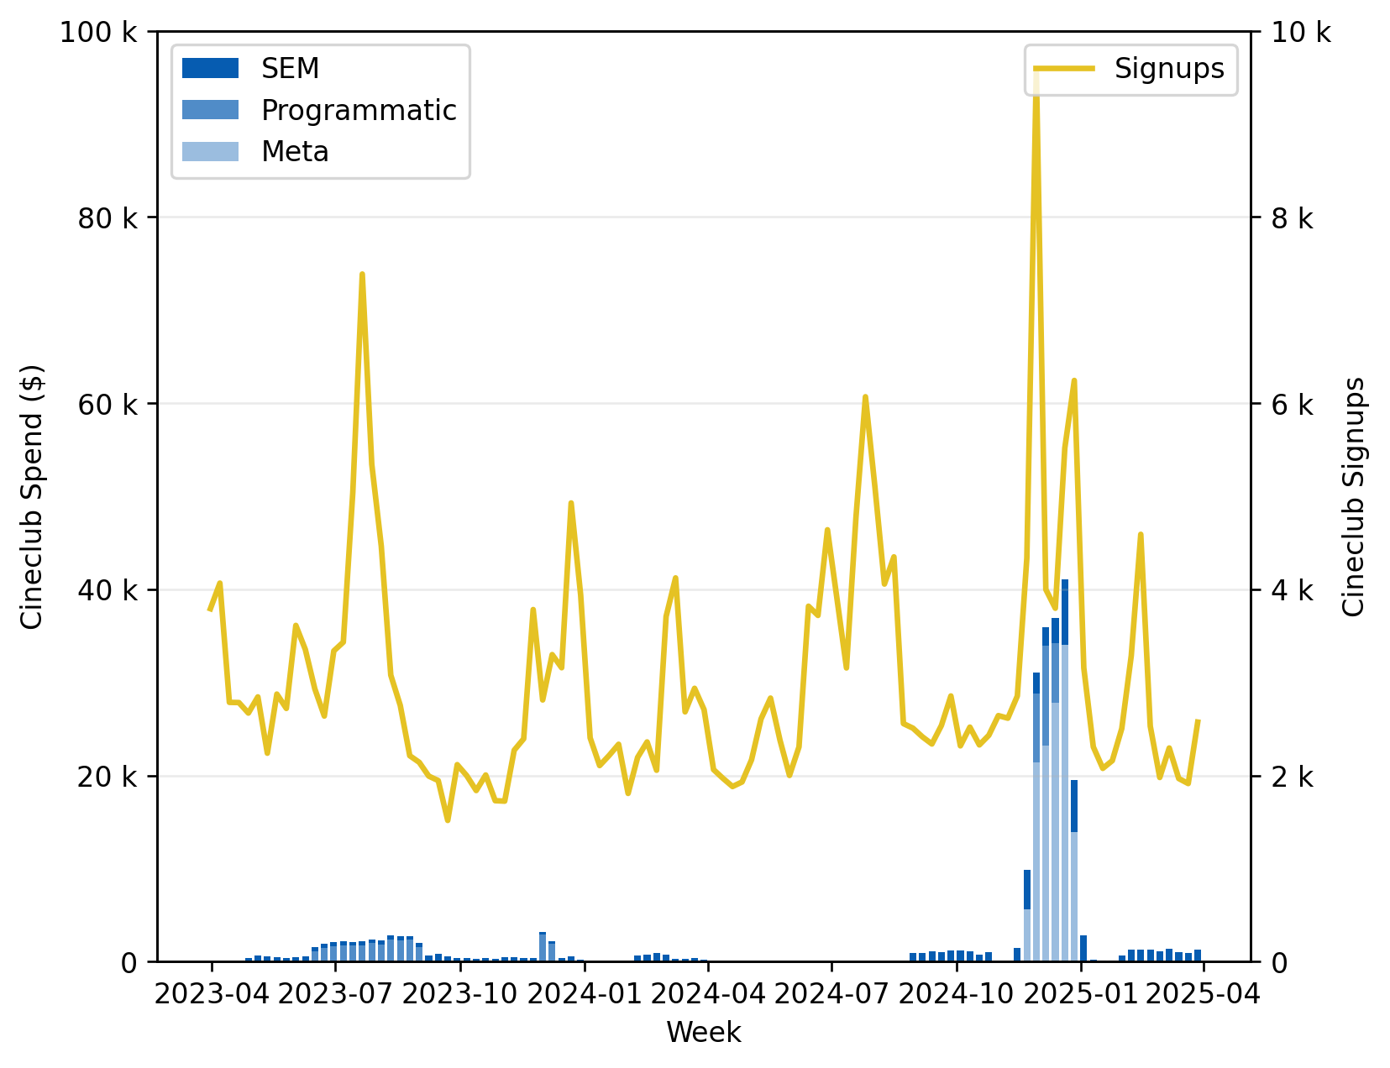
Cineclub Spend vs signups
Relationship between Cineclub spend and signup conversions for SEM, Programmatic, Meta. This view not only shows the proportionate relationship between each channel spend and signup but also displays the aggregate relationship.
Notes:
Correlation coefficient = 0.47, meaning there is moderate positive correlation between total Cineclub spend and signups
Spend occurs after a spike in signups in Q4 2024
ROI decreases after initial spend in the first week of December
*Data covers Q2 2023 to Q1 2025
*Data does not consider external factors such as weather, holidays

Slide 59
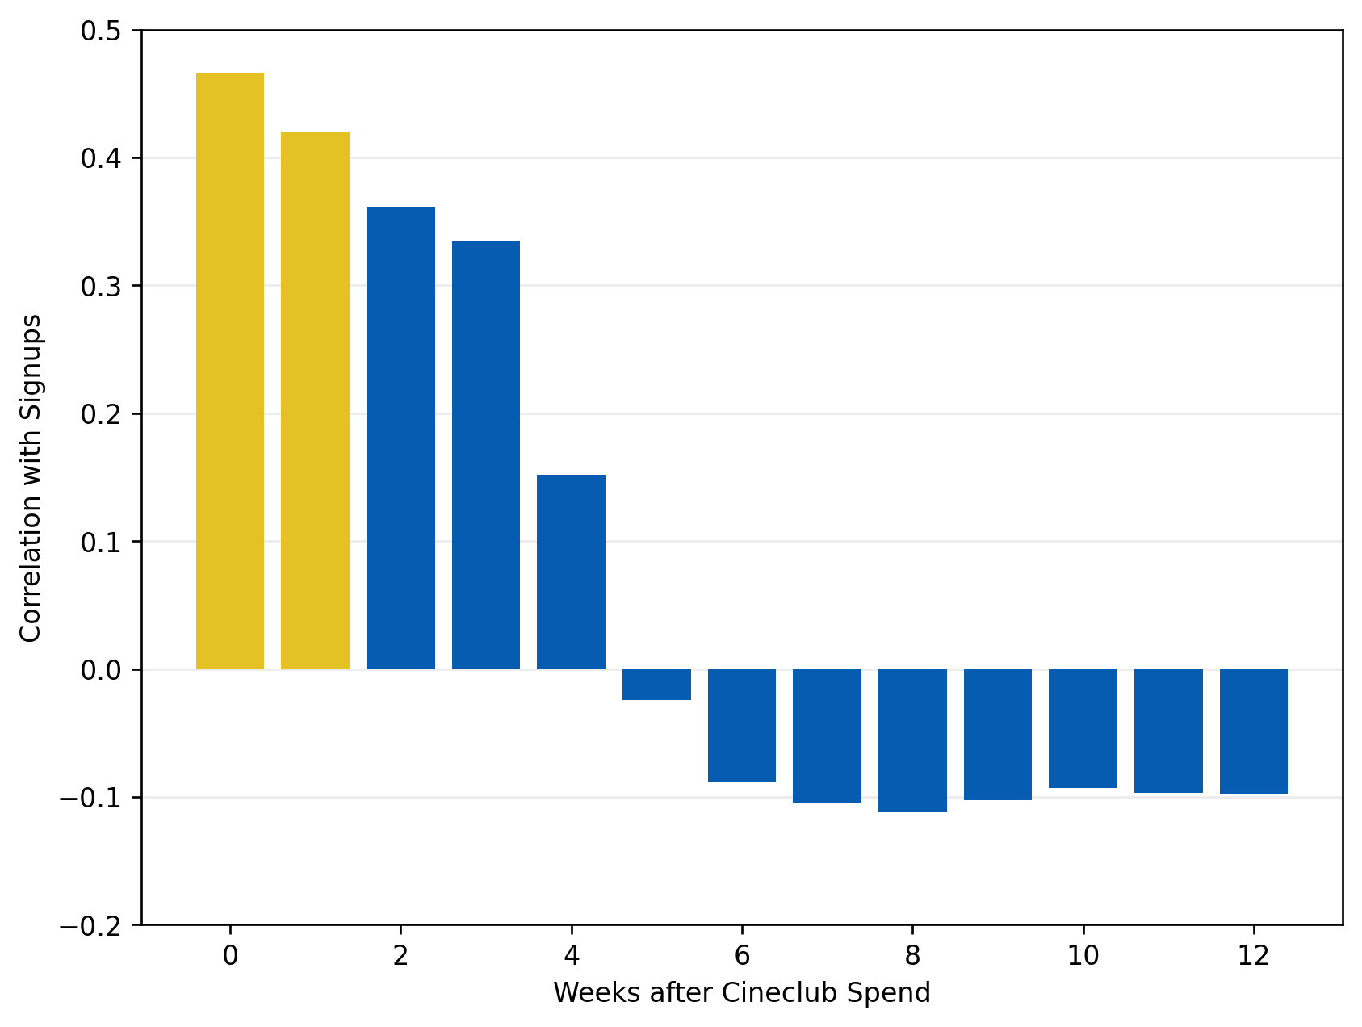
Cineclub Spend vs signups
This chart displays how Cineclub marketing spend relates to new sign-ups over the weeks following that spend.
Notes:
Immediate impact has strongest effect
The effect of weekly spend decays slowly and remains until roughly 3 weeks post the spend
After 4 weeks the carry-over effect dies out significantly
Transition to negative correlation occurs around week 5
Negative correlation indicates the relationship is effectively insignificant, meaning no insight can be drawn
*Data covers Q2 2023 to Q1 2025
*Data does not consider external factors such as weather, holidays

Slide 60
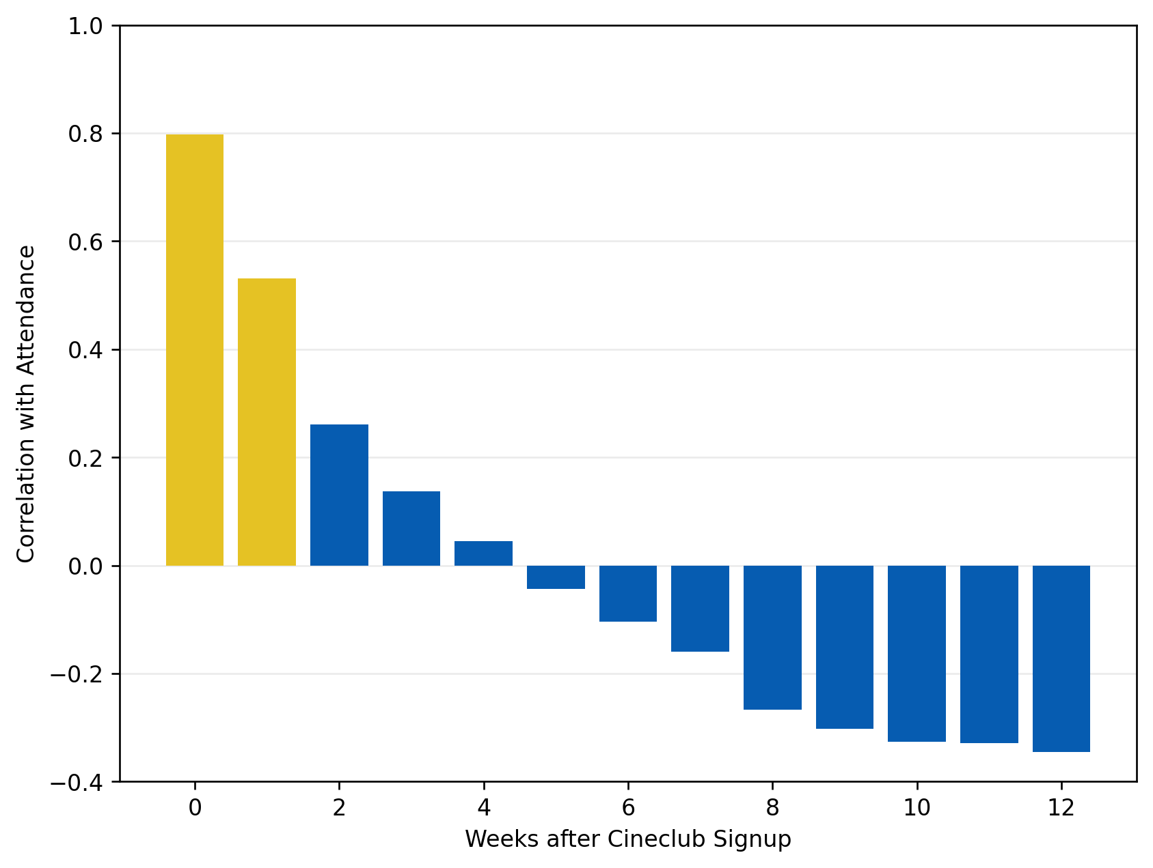
Cineclub signups vs attendance
This chart displays how Cineclub sign-ups correlates with actual attendance over the weeks following that spend.
Notes:
Immediate impact has strongest effect
The effect of weekly spend decays quickly and remains until roughly 1 week post the spend
After 1 week the carry-over effect dies out significantly
Transition to negative correlation occurs around week 5
  This aligns with correlation between spend & sign-ups
Negative correlation indicates the relationship is effectively insignificant, meaning no insight can be drawn
*Data covers Q2 2023 to Q1 2025
*Data does not consider external factors such as weather, holidays

Slide 61
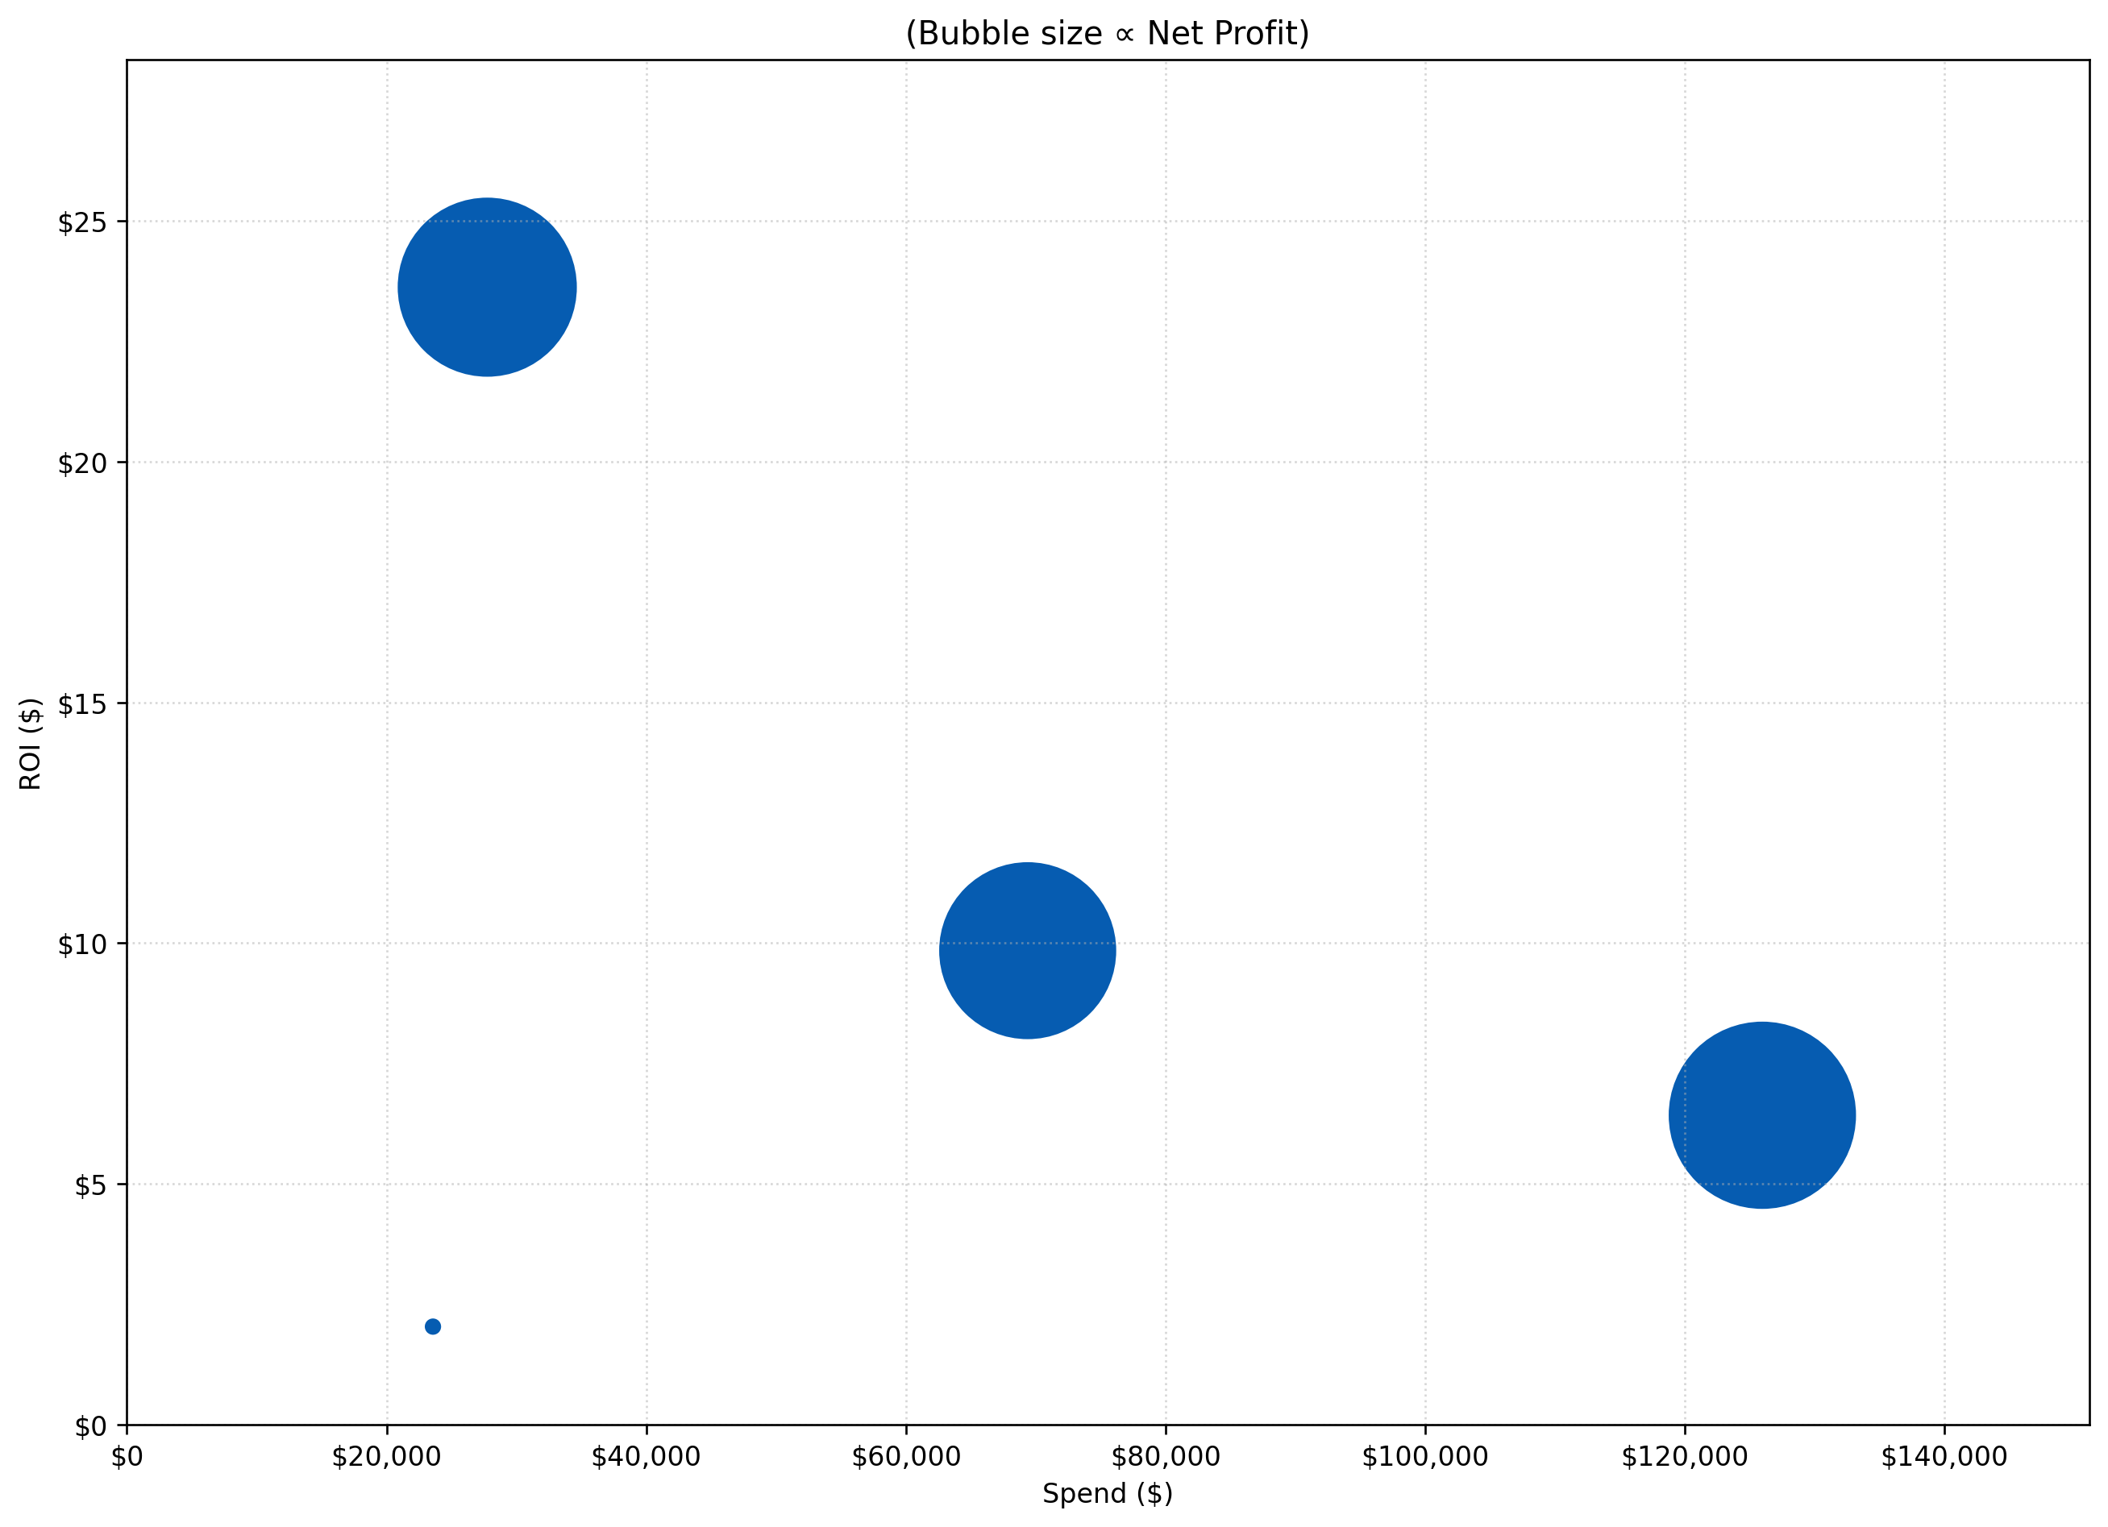
cineclub SPEND, REVENUE & ROI BY channel
Summary of LOB spend vs ROI in all Cineclub campaigns
Bubble size indicates relative net profit
Notes:
Programmatic Display had a low spend but the highest ROI at around 24, indicating high efficiency
Programmatic Video had lowest ROI
Meta had highest spend but only an ROI of around 6, the second-lowest
Programmatic Display ($630K)
SEM ($610K)
Meta ($680K)
Programmatic Video ($25K)
*Data covers Q2 2023 to Q1 2025
*Data does not consider external factors such as weather, holidays

Slide 62
IMAX
Notes:
30:00

Slide 63
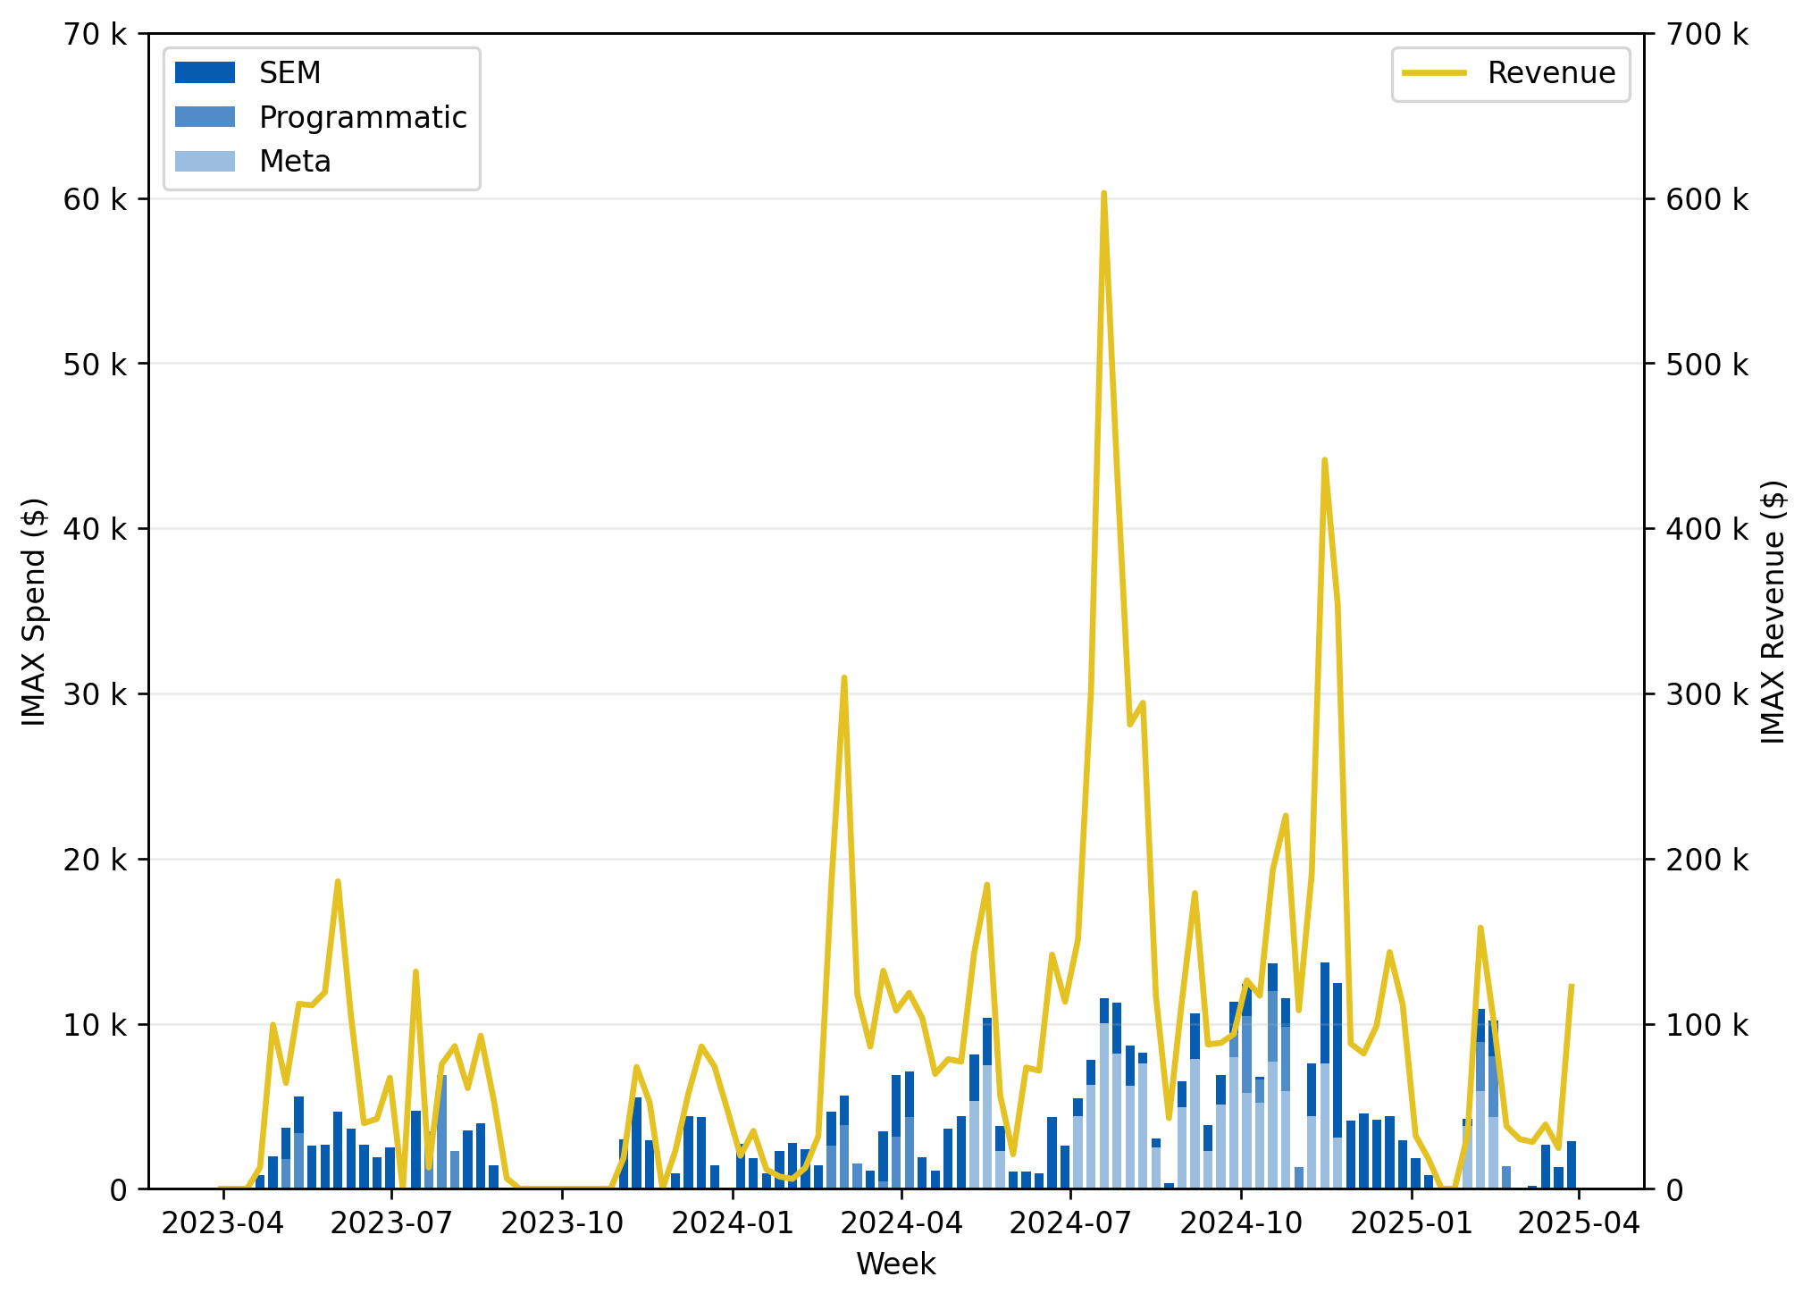
Weekly Imax spend vs Revenue
Relationship between IMAX spend and revenue for SEM, Programmatic, Meta.
Notes:
Correlation coefficient = 0.76, meaning there is strong positive relationship between IMAX spend and generated revenue
*Data covers Q2 2023 to Q1 2025
*Data does not consider external factors such as weather, holidays

Slide 64
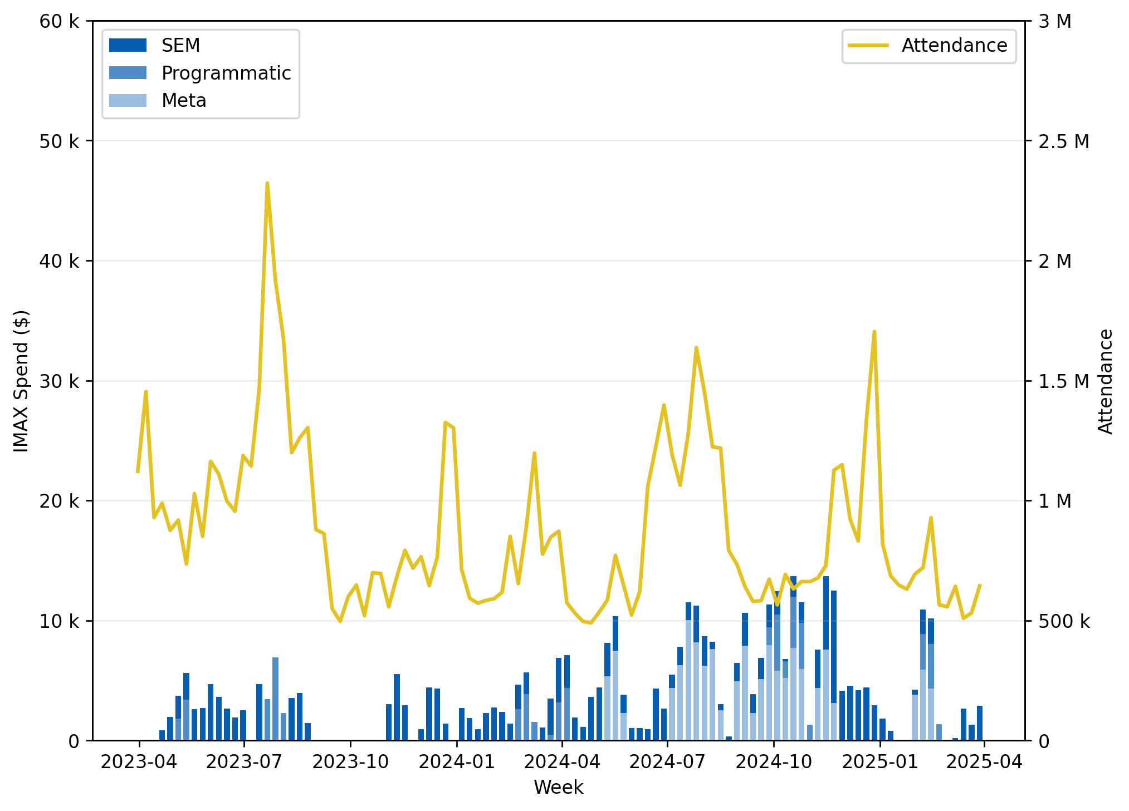
Weekly Imax spend vs attendance
Relationship between IMAX spend and attendance for SEM, Programmatic, Meta.
Notes:
Correlation coefficient = 0.25, meaning there is weak positive relationship between IMAX spend and attendance
*Data covers Q2 2023 to Q1 2025
*Data does not consider external factors such as weather, holidays

Slide 65
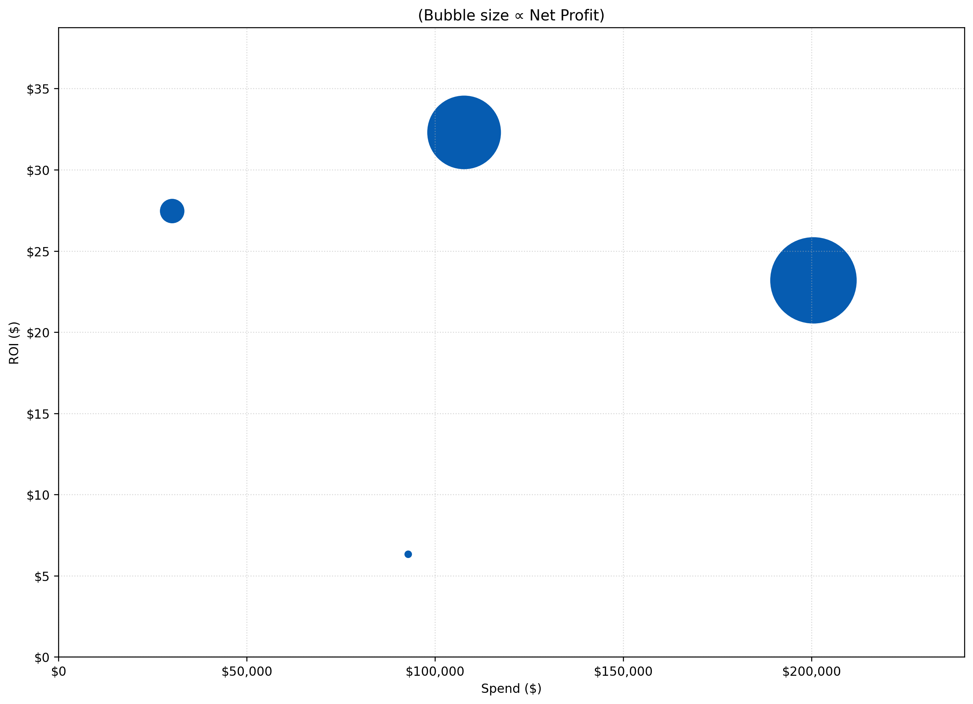
Imax SPEND, REVENUE & ROI BY channel
Summary of LOB spend vs ROI in all IMAX and Enhanced Experiences campaigns
Bubble size indicates relative net profit
Notes:
Programmatic Video with average spend but lowest ROI by a significant margin
Meta with the lowest spend but second-highest ROI
Programmatic Display had average spend and highest ROI
Programmatic Display ($3M)
Meta ($0.8M)
SEM ($4M)
Programmatic Video ($0.5M)
*Data covers Q2 2023 to Q1 2025
*Data does not consider external factors such as weather, holidays

Slide 66
Performance
Notes:
32:00

Slide 67
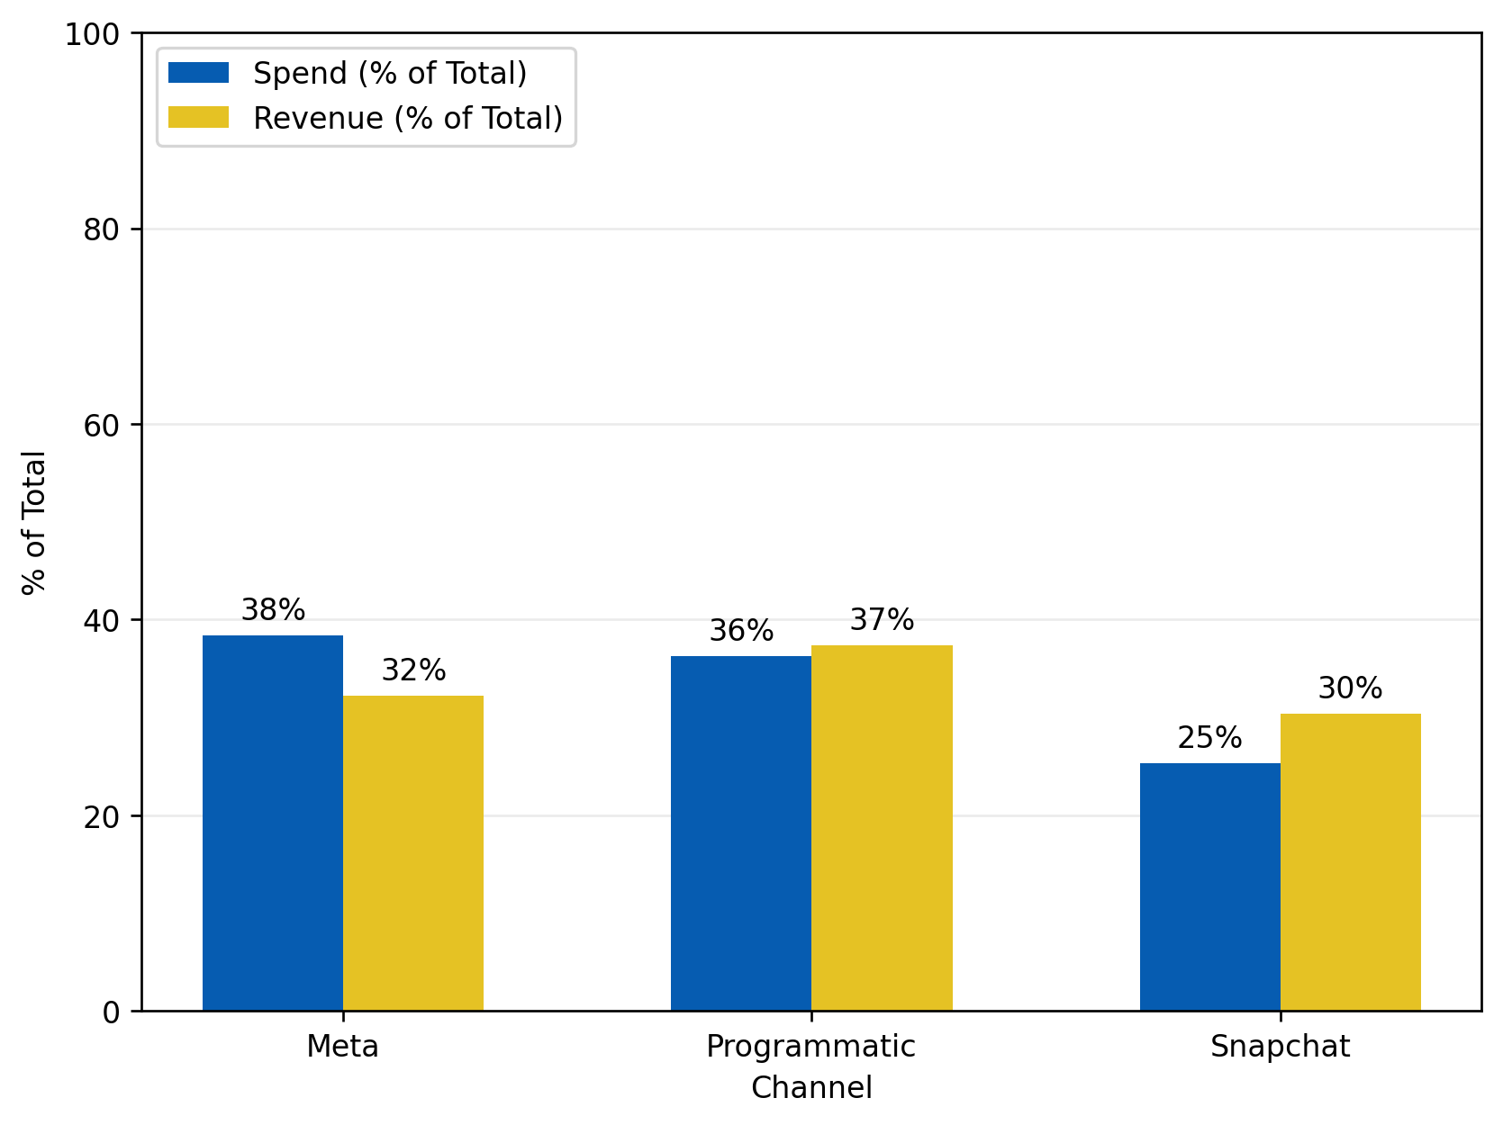
Performance spend by channel vs revenue
Comparison of where budget is allocated vs where revenue is generated across the lines of businesses in the performance LOB with the purpose of attendance conversion/revenue generation.
Notes:
Programmatic / Snapchat return higher proportions of revenue relative to the ratio of budget allocated making them more efficient
Meta on the other hand returns a smaller proportion of revenue compared to the budget allocated
*Data covers Q2 2023 to Q1 2025
*Data does not consider external factors such as weather, holidays

Slide 68
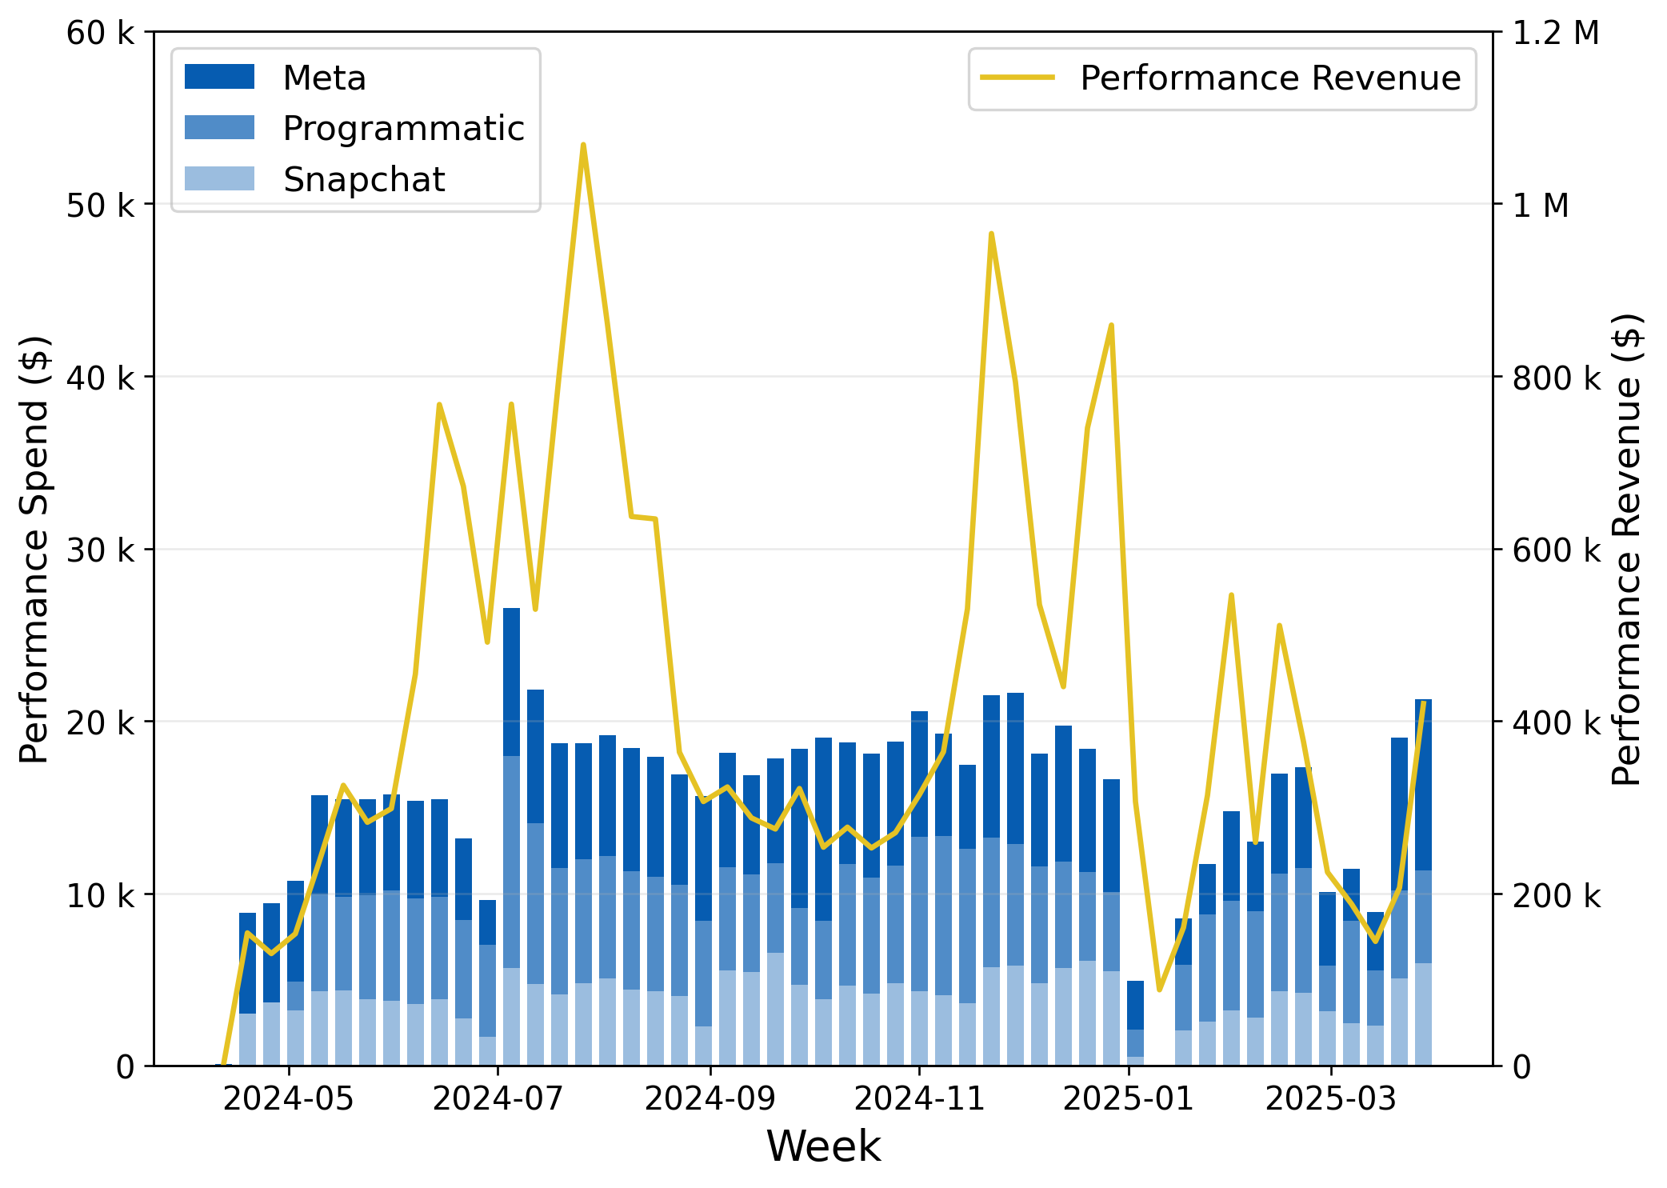
Weekly performance spend vs revenue
Relationship between Performance spend and revenue for Meta, Programmatic, Snapchat.
Notes:
Correlation coefficient = 0.56, meaning there is moderate positive relationship between Performance spend and generated revenue
Not all spikes align between the line and bar graphs meaning the overall revenue may be impacted heavily by external factors
*Data covers Q2 2023 to Q1 2025
*Data does not consider external factors such as weather, holidays

Slide 69
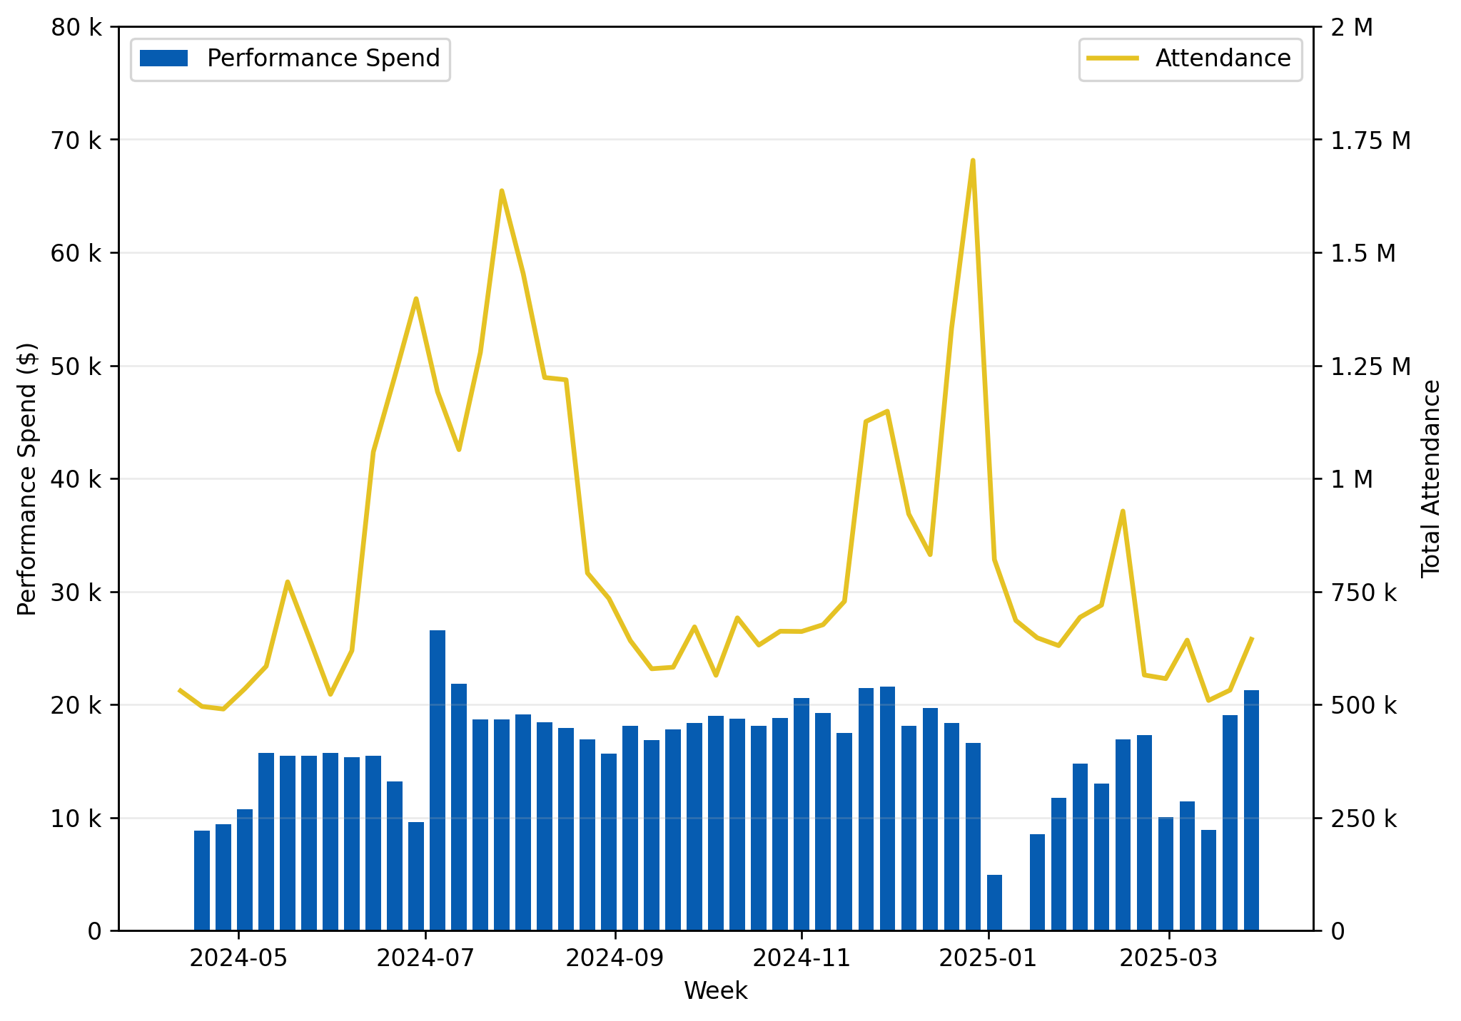
Weekly performance spend vs attendance
Relationship between Performance spend and overall attendance.
Notes:
Correlation coefficient = 0.32, meaning there is weak positive relationship between Performance spend and generated revenue
Not all spikes align between the line and bar graphs meaning the overall attendance may be impacted heavily by external factors

Slide 70
G&E
Notes:
34:00

Slide 71
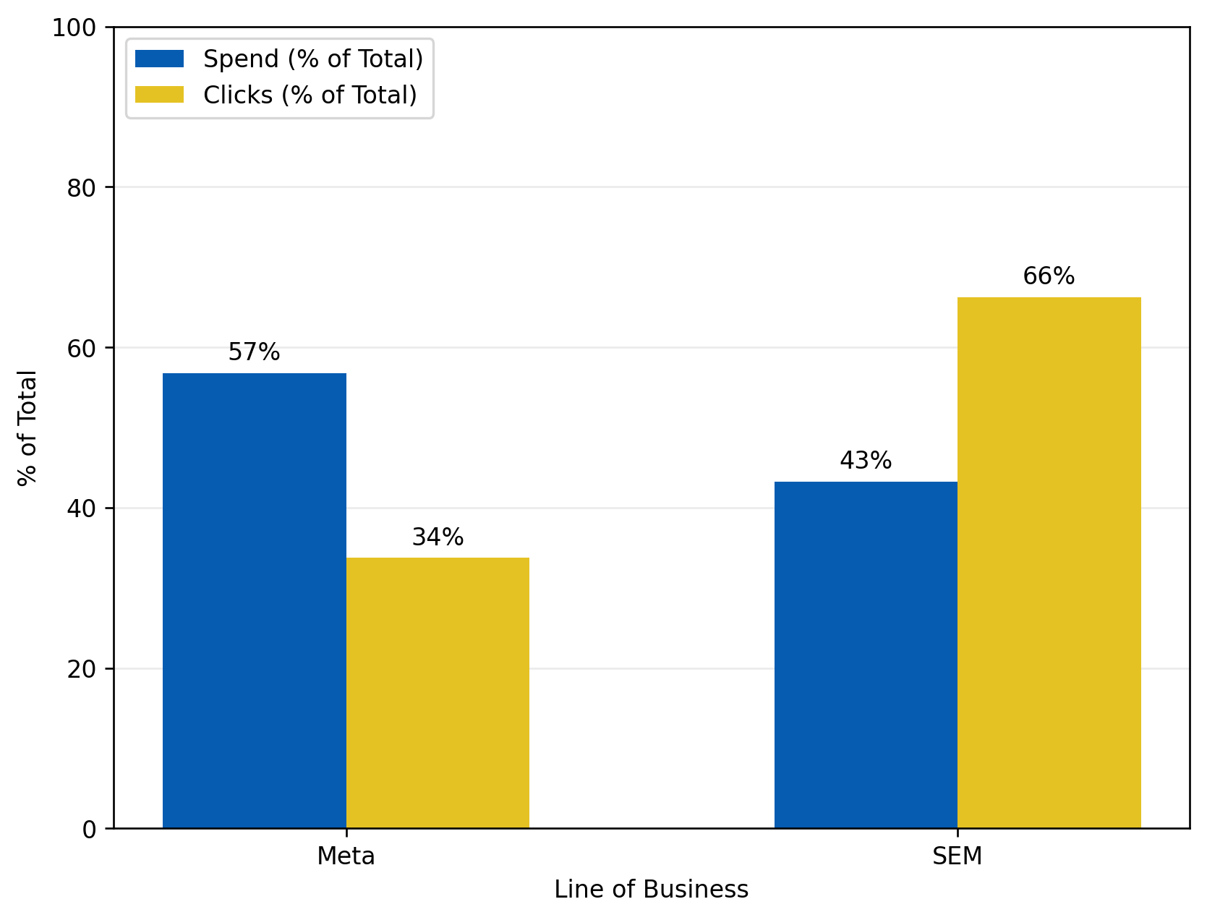
G&e Spend by Channel vs clicks
Comparison of the amount spent vs where actual clicks are generated across the lines of businesses in G&E.
Notes:
Meta has relatively higher allocated budget, but returns a smaller proportion in clicks
SEM on the other hand has less allocated budget returns a higher proportion in clicks
*Data covers Q2 2023 to Q1 2025
*Data does not consider external factors such as weather, holidays

Slide 72
pREPAID
Notes:
35:00

Slide 73
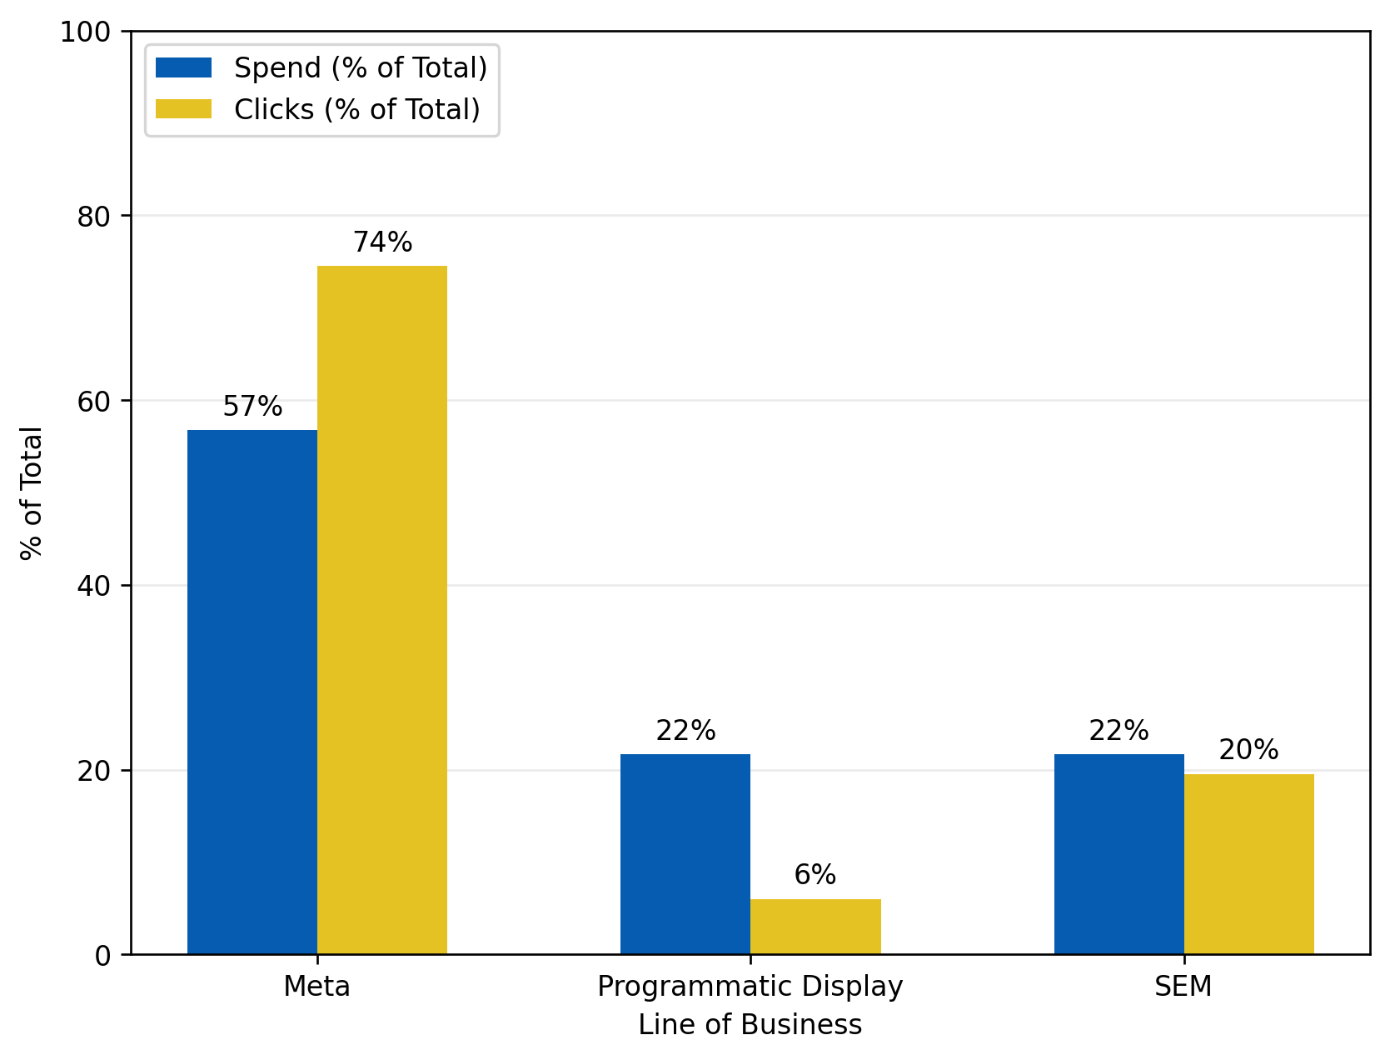
Prepaid SPEND by channel vs clicks
Comparison of the amount spent vs where actual clicks are generated across the lines of businesses in Prepaid.
Notes:
Meta has highest budget allocated and returns highest proportion in clicks, showing a stronger performance compared to G&E
Programmatic display and SEM have same budget allocation, but SEM has relatively higher click generation
*Data covers Q2 2023 to Q1 2025
*Data does not consider external factors such as weather, holidays

Slide 74
Fighter mode: LOBs on a mission
Key Takeaways:
Brand: Strong contributor in Awareness and Consideration with well aligned spend, but less efficient in Conversion. The budget here should focus more on upper funnel.
Cineclub: Underfunded in Awareness; spend shows moderate impact on sign-ups. Programmatic channels deliver better ROI than Meta.
Prepaid: Highly efficient in Consideration. Low spend yields high impact. Should maintain or slightly grow budget.
Exhibition SEM and Performance: moderate spend yields high attendance and profit. Great opportunity to scale.
G&E: High spend but limited contribution in Consideration; SEM outperforms Meta for clicks. The budget could be optimized.
IMAX: Reliable ROI and strong revenue correlation, best results through Programmatic Display.

Slide 75
Fighter mode: LOBs on a mission
Strategic Focus:
Focus Brand spend in Awareness/Consideration, limit Conversion push.
Increase SEM and Convert & Upgrade spend in Conversion, where ROI is proven strongest.
Maintain Prepaid as an efficient Consideration driver.
Optimize Cineclub by focusing spend on high ROI channels (Programmatic) and monitoring flight for sign up impact.
Optimize G&E spend, prioritize SEM for efficiency.
Test Snapchat and Programmatic Display more broadly in Performance campaigns to capture untapped revenue.

Slide 76
Q&A

